Slide 1
Process Documentation of Monitoring & Securing a Web Application

Slide 2
Services used for Project
1.IAM (Identity & Access Management)
- Users
2.VPC (Virtual Private Cloud)
- VPC & Subnets
- Internet Gateway & NAT Gateway
- Route Tables
3.EC2 (Elastic Compute Cloud)
- Security Groups
- Instance
4.S3 (Simple Storage Service)
- Bucket

Slide 3
5.Amazon Cloud Watch
- Metrics
- Widgets
6. Cloud Trail logs
- Trail
- Logs

Slide 4
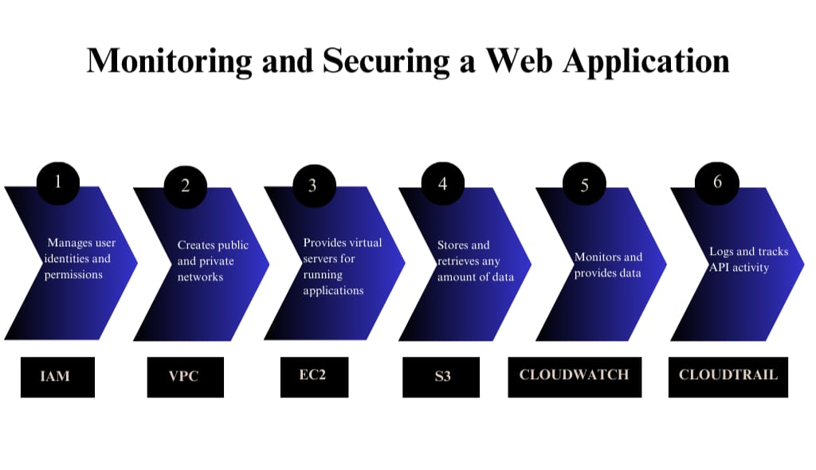
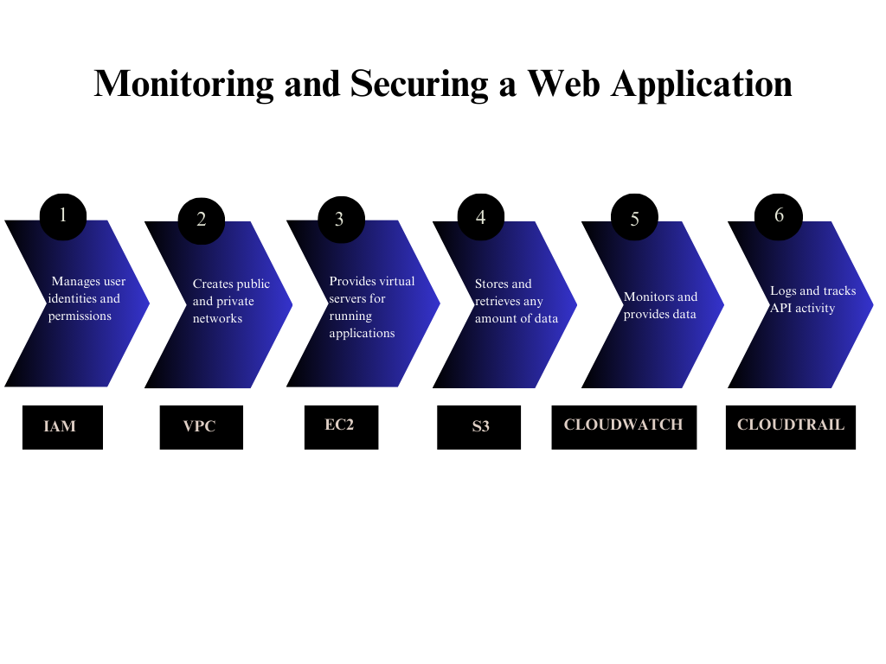
Flowchart of the Project

Slide 5
1.Sign-in to AWS Root Account
1.Search for AWS Management Console in Browser.
2.Open to the AWS Management Console.
3.Click on “Sign In to the Console”.
4.Choose “Root user” as the login method.
5.Enter Email and Password that is associated with your AWS root account.
6.Click on Sign in.

Slide 6
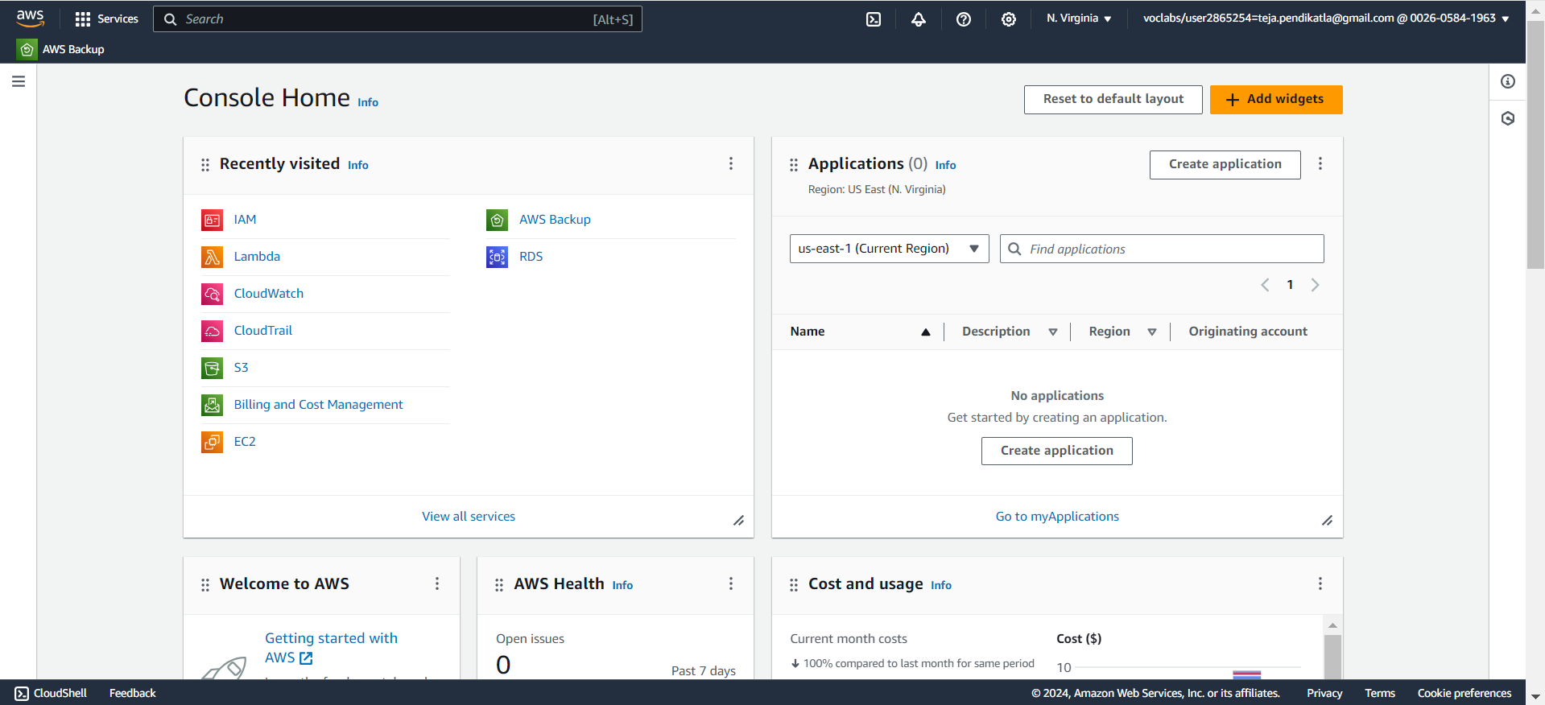
1.1 AWS Console Home.

Slide 7
2.SETTING UP IAM
1.Open AWS dashboard in AWS Management Console.
2.Search for IAM in Search bar and open IAM dashboard.
3.Go to Users and create the number of users based on your requirement ,we don’t have the requirement to create a Group as of now, because we are creating a single IAM user.
4.Configure the name of the user , and Click on Checkmark - Custom password and Click on Checkmark User must create a new password at next sign-in.
5.Now Select - Attach Policies Directly in Permission Options and Search the required permissions for the IAM user account that we are creating.
6.Now we are Selecting required permissions to our IAM user based on our project requirements in Permissions Policies.
7.IAM Full Access , AmazonEC2FullAccess , AmazonVPCFullAccess , AmazonS3FullAccess, CloudWatchFullAccess , AWSCloudTrail_FullAccess.
8.After selecting the permissions click on Create user.

Slide 8
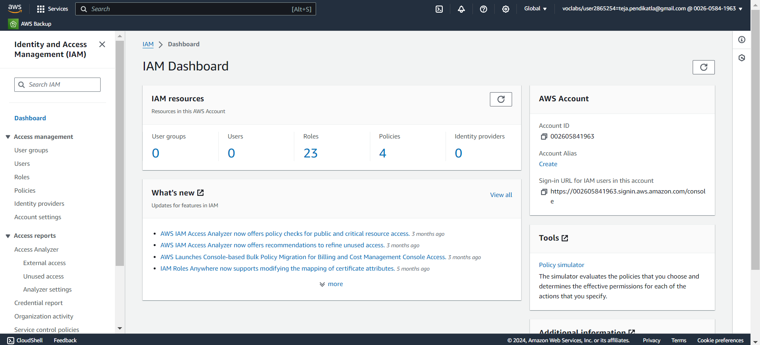
2.1 Search for IAM Services in AWS Console Home & Open.

Slide 9
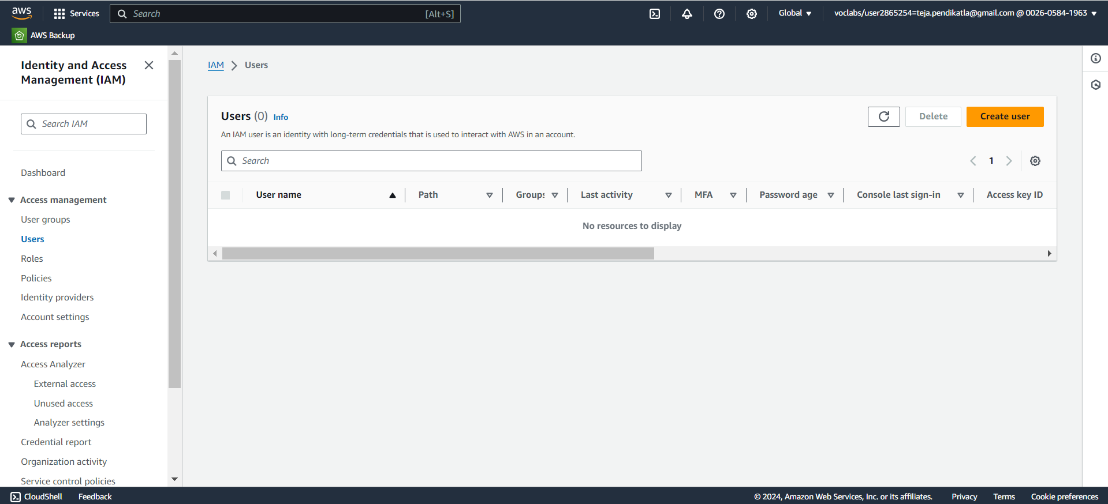
2.2 Create New User in IAM Dashboard.

Slide 10
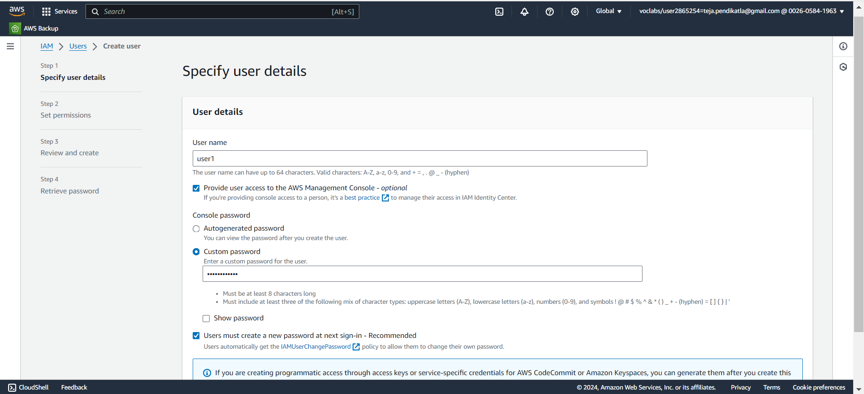
2.3 Custom User name and follow the steps in IAM Creation.

Slide 11
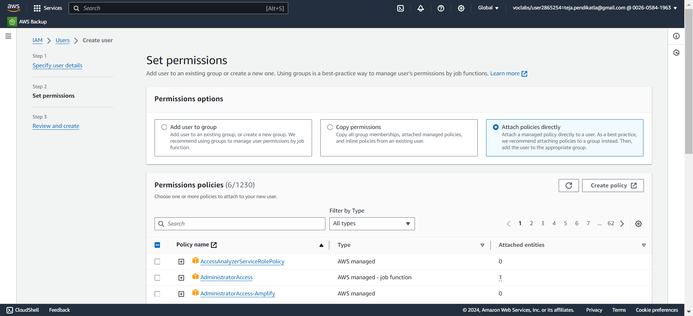
2.4 Select Permissions option and search for appropriate Permissions.

Slide 12
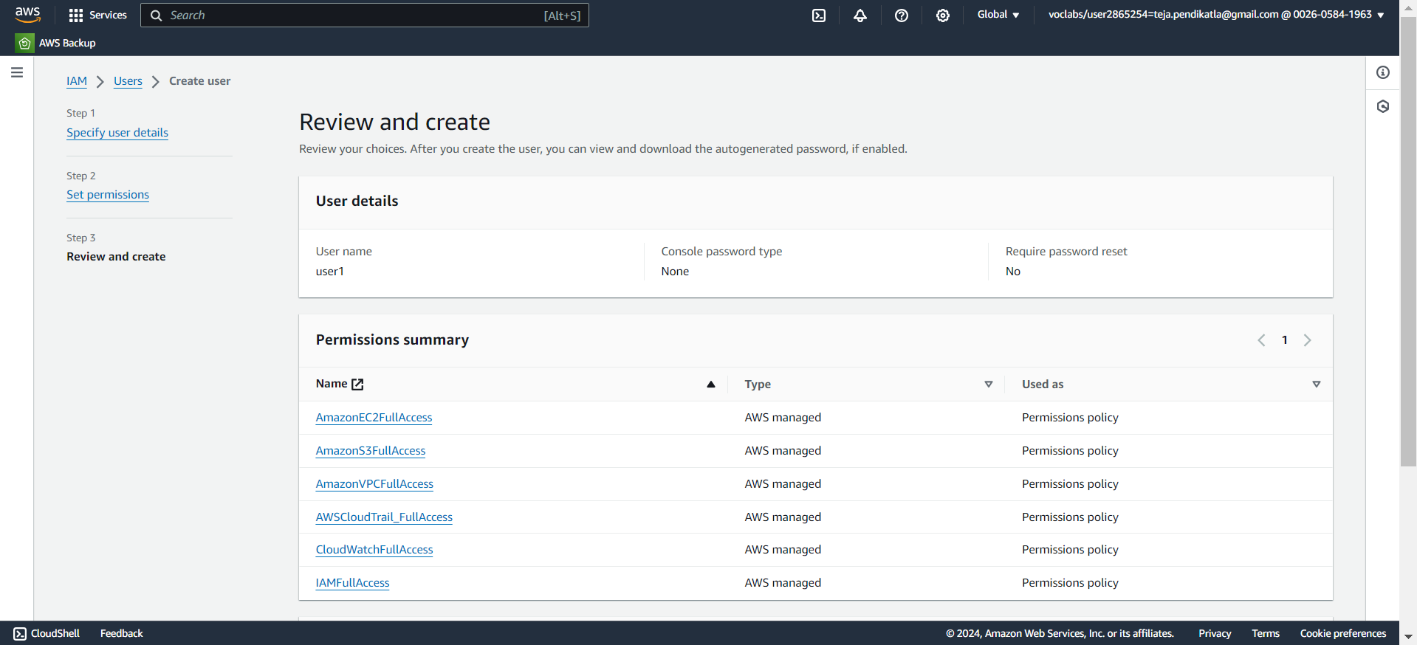
2.5 Select the following Permissions and Click on Create user.

Slide 13
3.SETTING UP VPC
1.Open AWS dashboard in AWS Management Console.
2.Search for VPC in Search bar and open VPC dashboard.
3.Click on create VPC ,Now select VPC only in VPC Settings and give a name to your VPC.
4.Select IPV4 CIDR – (10.0.0.0/24 , the block size is 64 Class C), and click on Create VPC.
5.In VPC dashboard now click on Subnets(We require 2 subnets based on requirement).
6.Select the created VPC in VPC ID , while creating subnet - Subnet 1 was created with subnet name as public1 , under the region us-east-1a, IPv4 VPC CIDR Block :10.0.0.0/24, IPv4 Subnet CIDR Block 10.0.0.32/27 .
7.Subnet 2 was created with subnet name as private1 under the region us-east-1b , IPv4 VPC CIDR Block :10.0.0.0/24, IPv4 Subnet CIDR Block 10.0.0.64/27 .
8.Two Subnets are successfully created in your VPC.

Slide 14
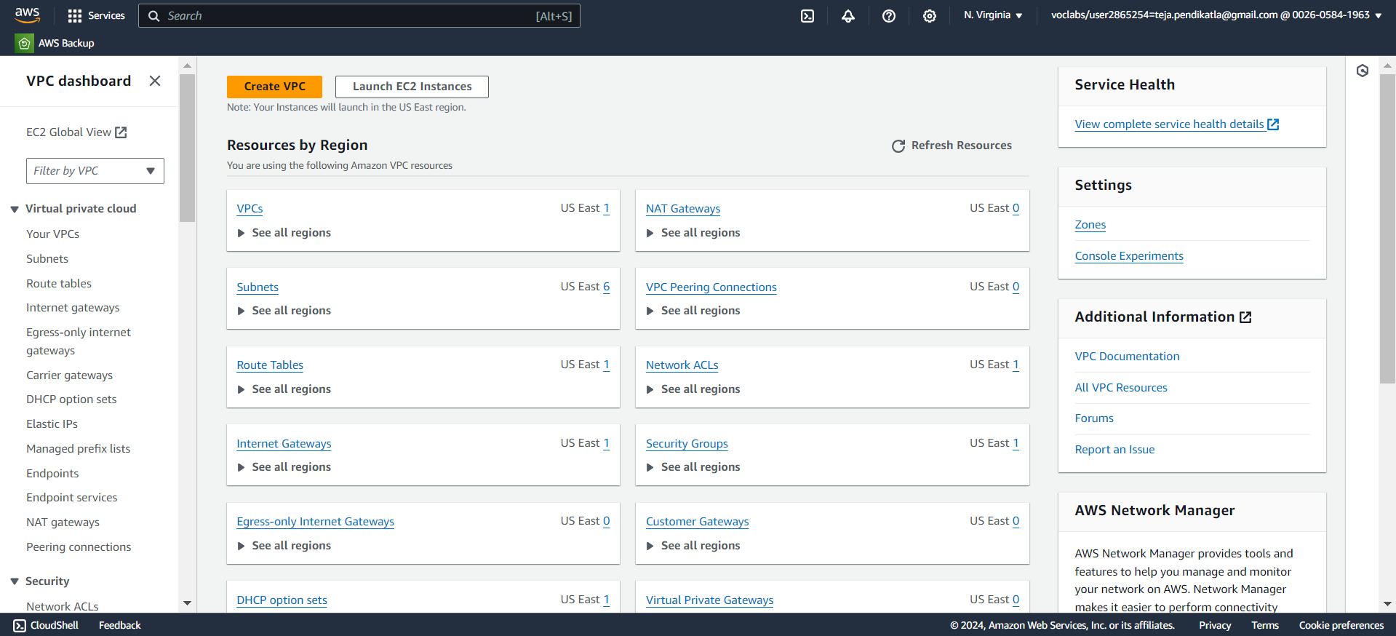
3.1 Search for VPC Services in AWS Console Home & Open.

Slide 15
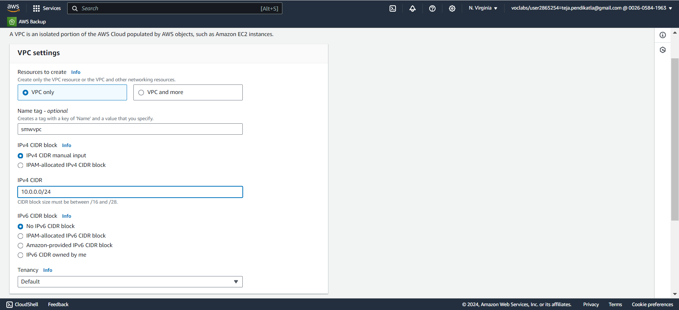
3.2 Click on Create VPC & Follow the steps in Setting up VPC.

Slide 16
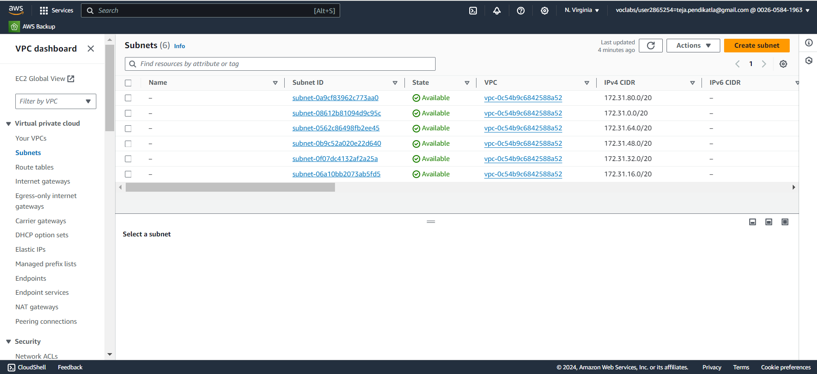
3.3 Click on Subnets in VPC Dashboard & Click on Create Subnet.

Slide 17
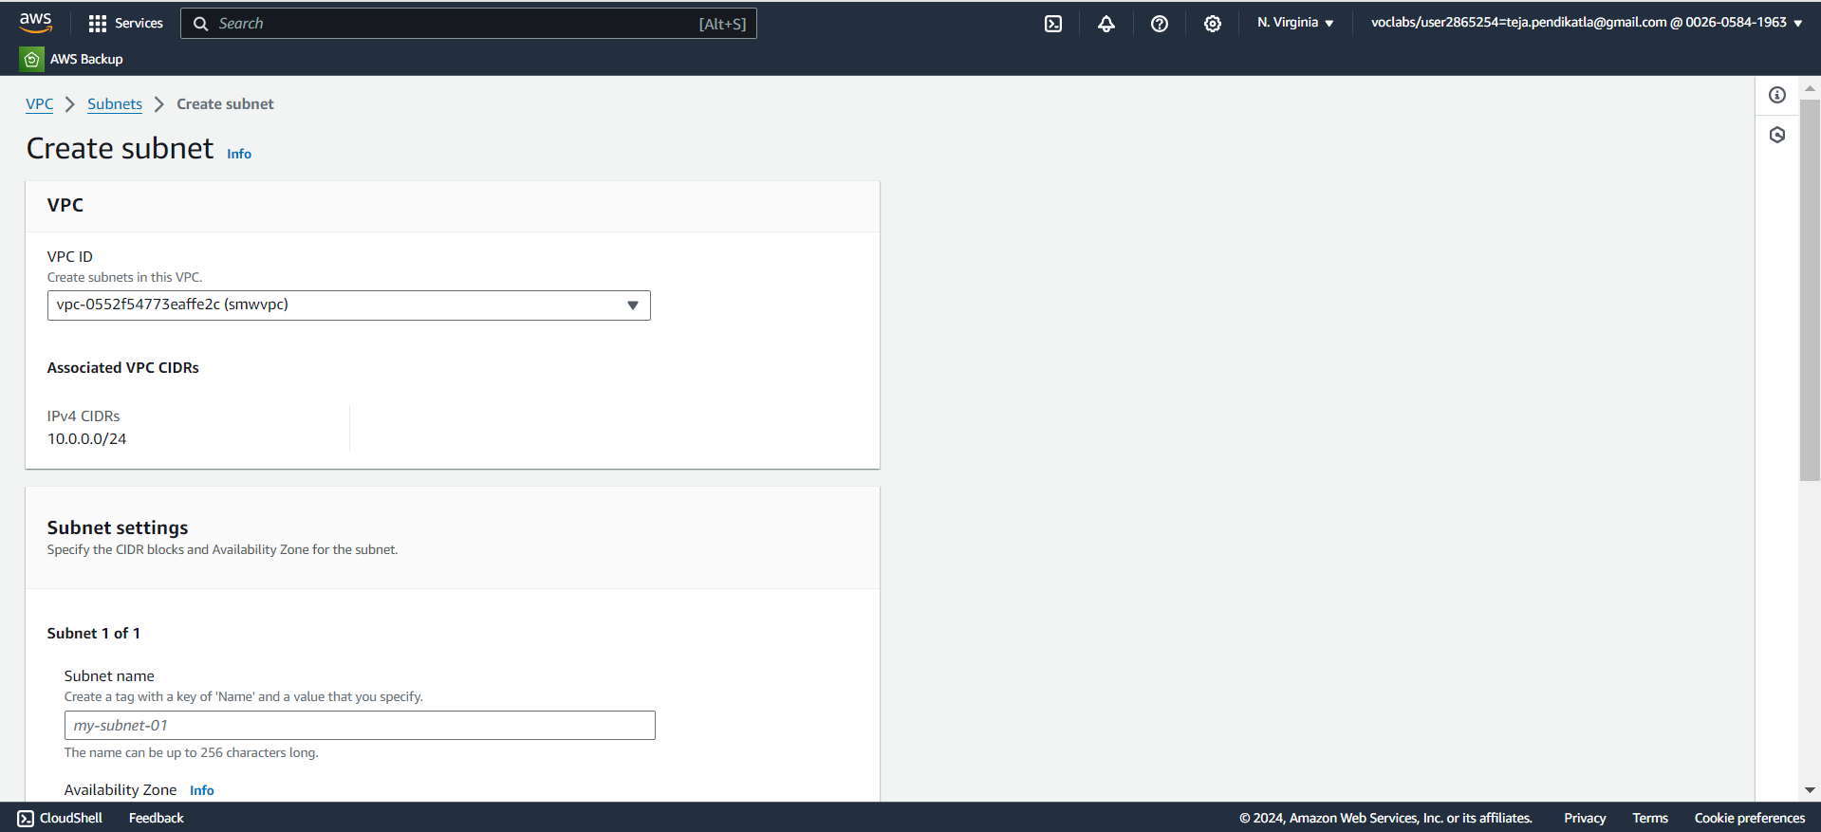
3.4 Select the Created VPC in VPCID & follow the steps in Set up VPC

Slide 18
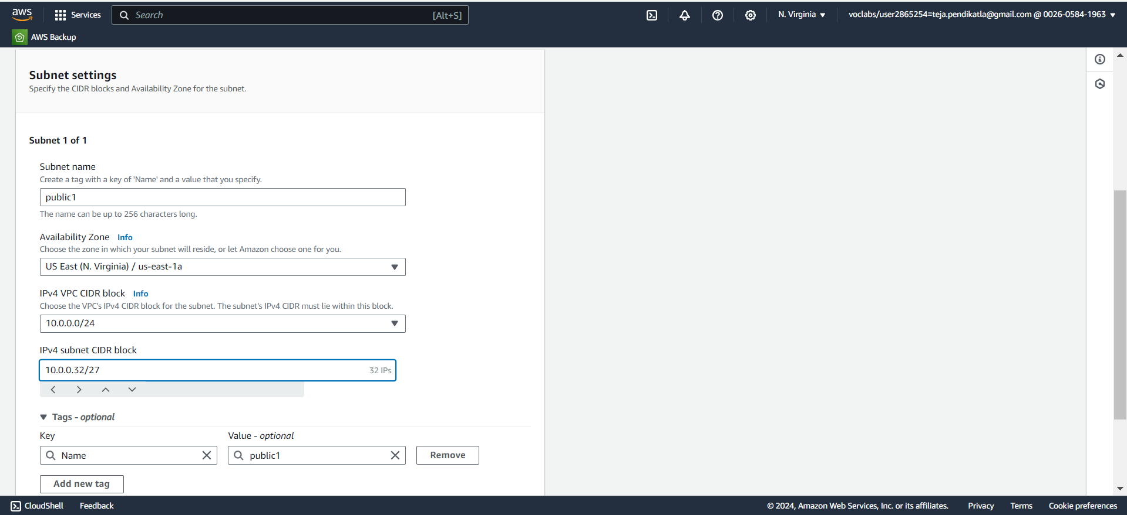
3.5 Setting up Public1 in VPC & follow the steps in Setting up VPC

Slide 19
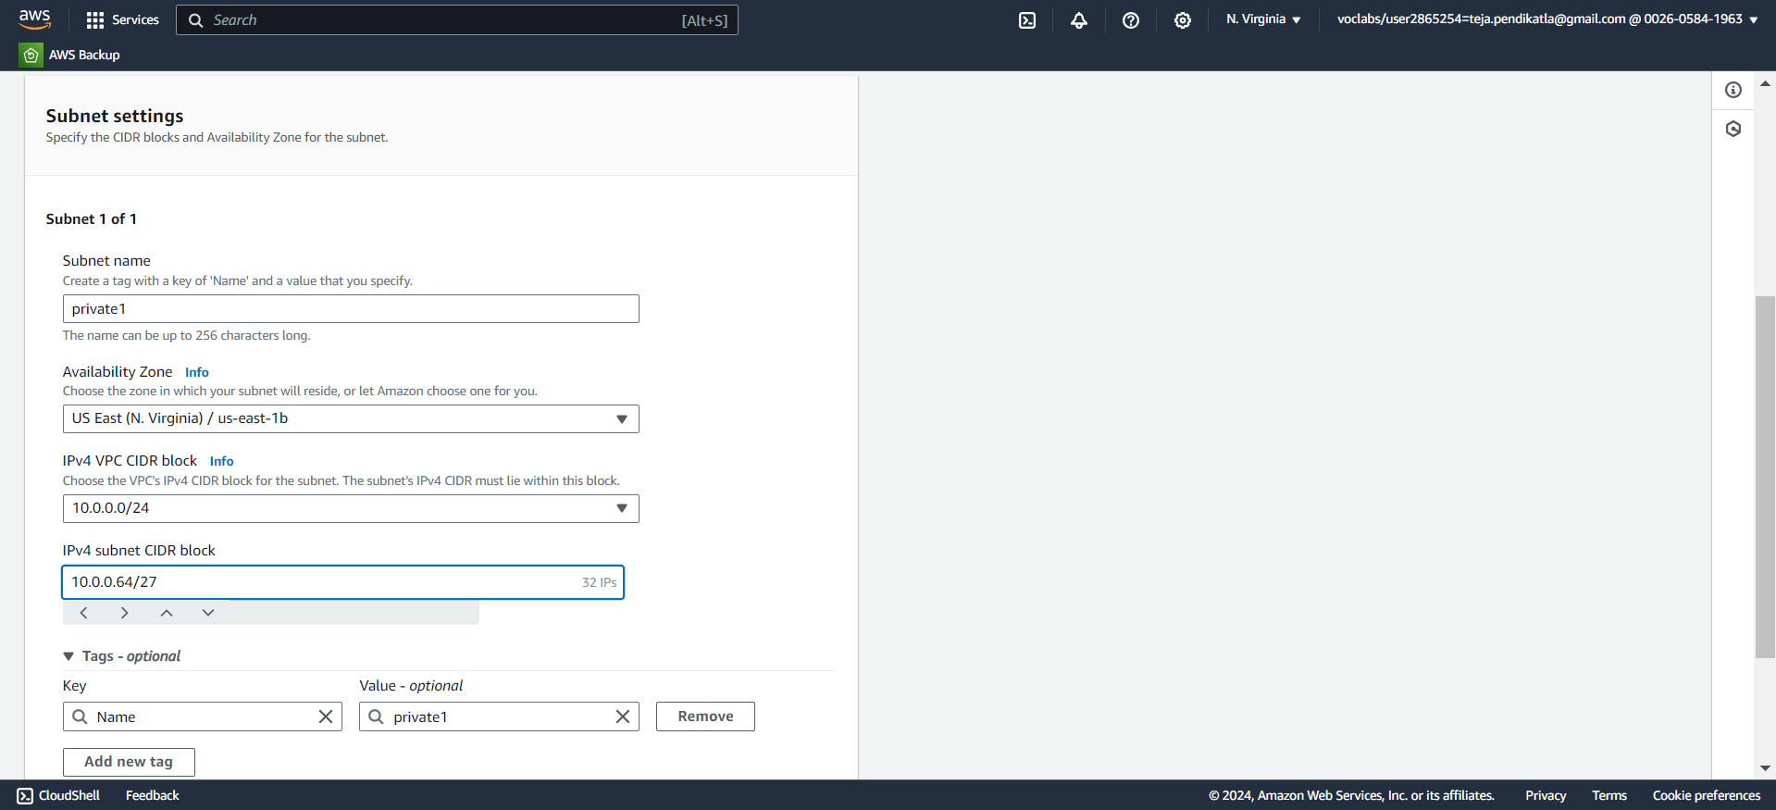
3.6 Setting up Private1 in VPC & follow the steps in Setting up VPC

Slide 20
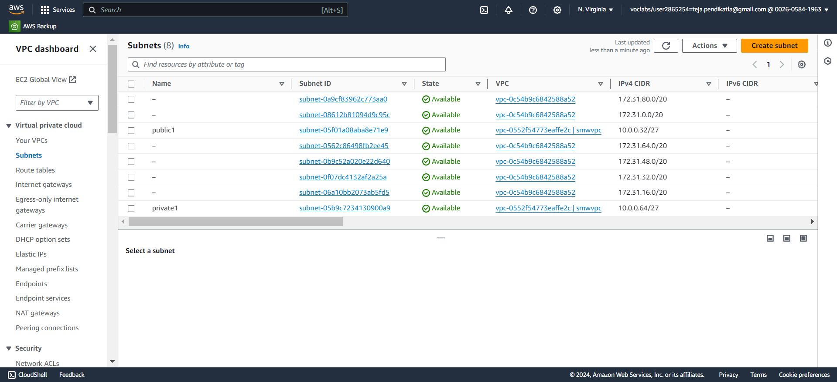
3.7 Subnets Public1 & Private1 are Created Successfully.

Slide 21
4.Setting Up Internet Gateway
1.In VPC dashboard ,Select Internet Gateway.
2.Create an Internet Gateway, give a name in name tag in internet gateway setting.
3.Create the Internet Gateway.
4.Click on the pop up or click on actions in top right corner to Attach to a VPC.
5.Select already created VPC in Available VPC’s and click on Attach Internet Gateway.
6.Internet Gateway is successfully attached to the existing or created VPC.

Slide 22
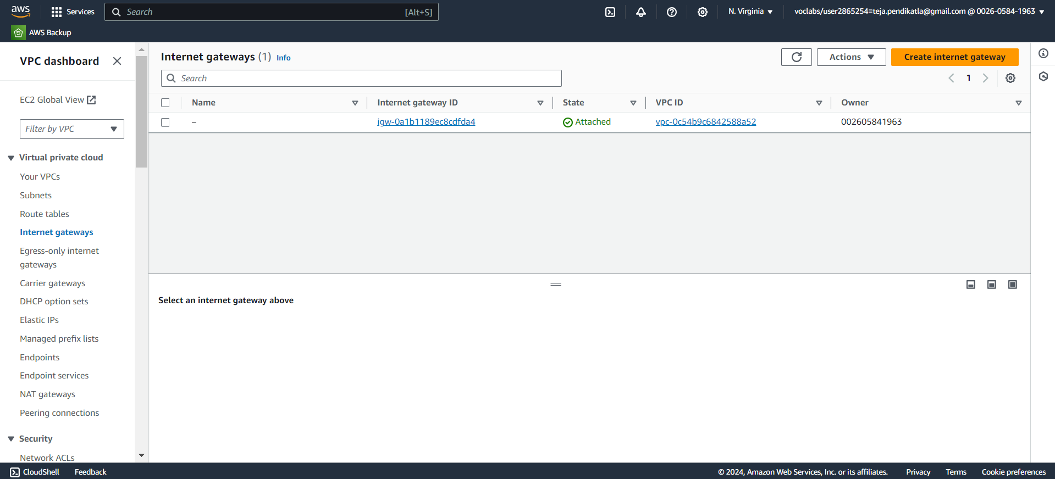
4.1 Create Internet Gateway.

Slide 23
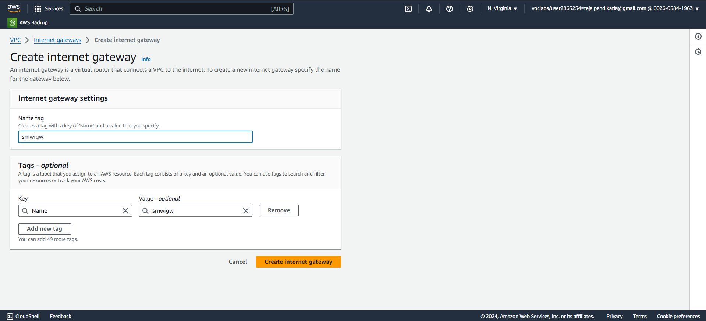
4.2 Give a name to Internet Gateway & Create Internet Gateway.

Slide 24
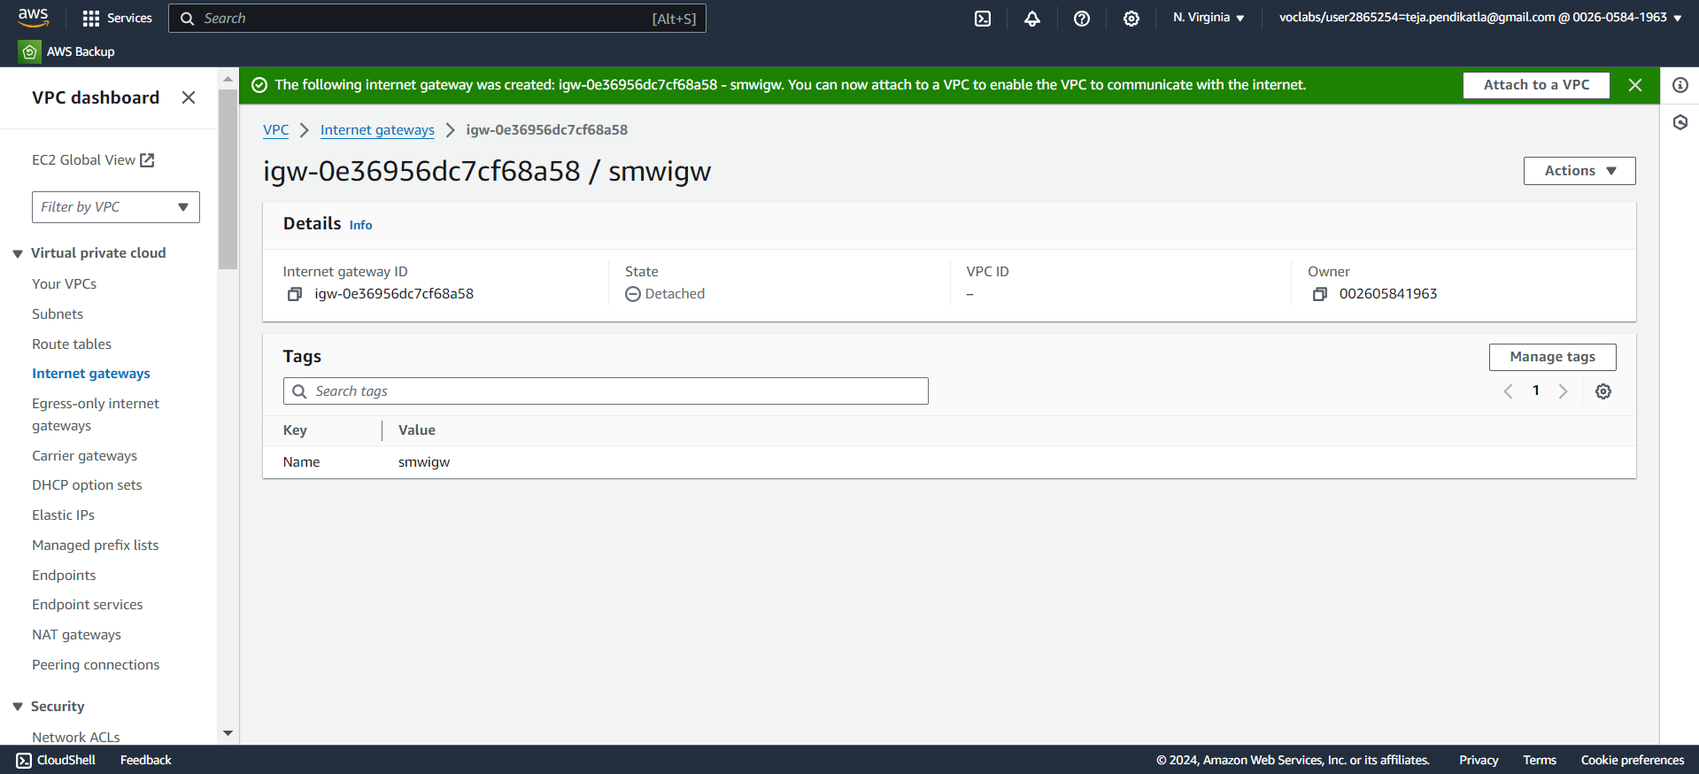
4.3 Click on Attach to a VPC.

Slide 25
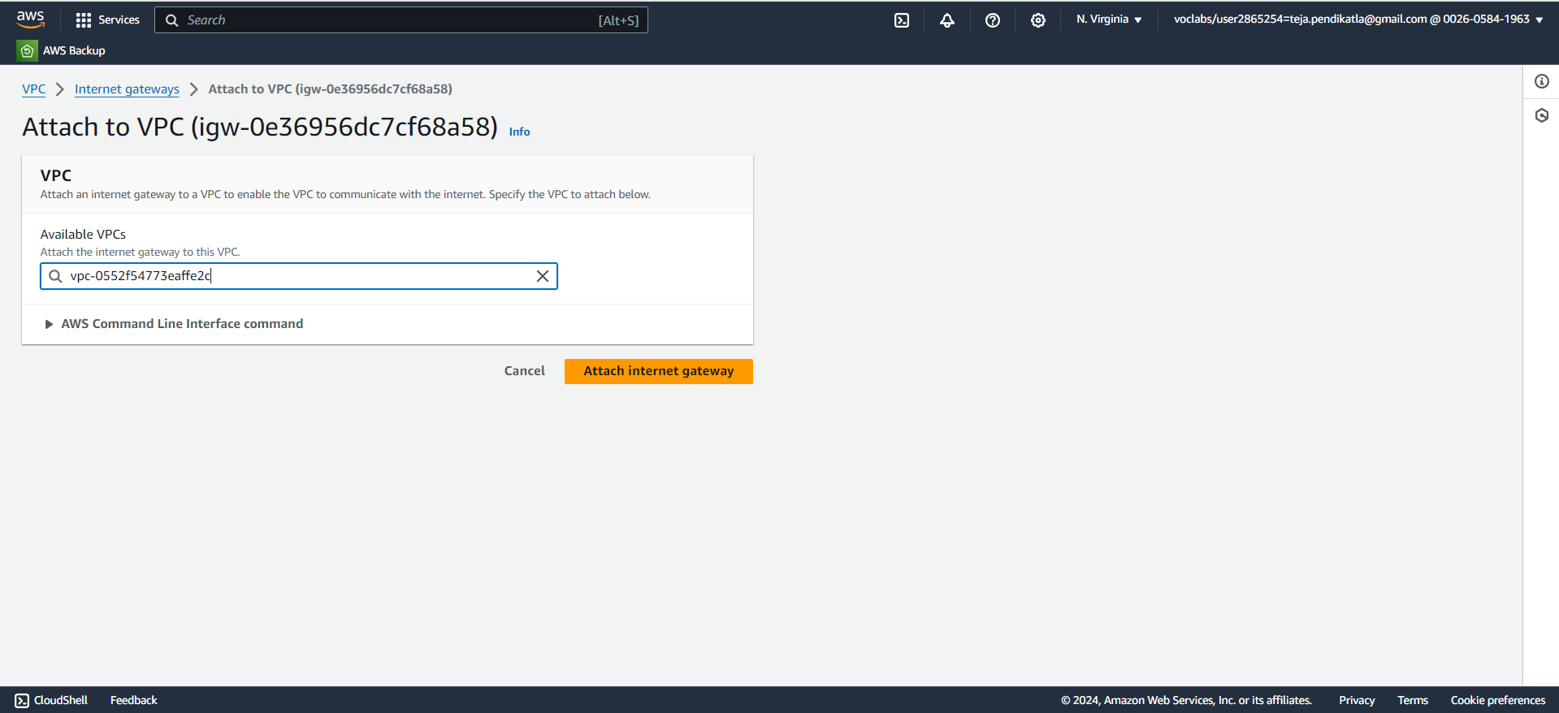
4.4 Select the created VPC and click on attach it to IGW.

Slide 26
5.Setup Default Route table of VPC
1.While creating VPC , a default RouteTable is created, Each subnet in your VPC is associated with a route table which controls the traffic flow between subnets.
2.Give a name as smwroute1 to the default created Routetable.
3.Select the default Route table - smwroute1
4.Click on Routes ,Click on edit route and add route – Choose 0.0.0.0 in left dropdown & Choose Internet Gateway in Right dropdown and exactly down to it select created Internet Gateway.
5.Click on Save changes.
6.Click on Subnet Associations , Click on edit Subnet Associations & select the public subnet created under VPC and Click on save changes.
7.Now we successfully updated the Routes and Subnet Associations of Default Route Table

Slide 27
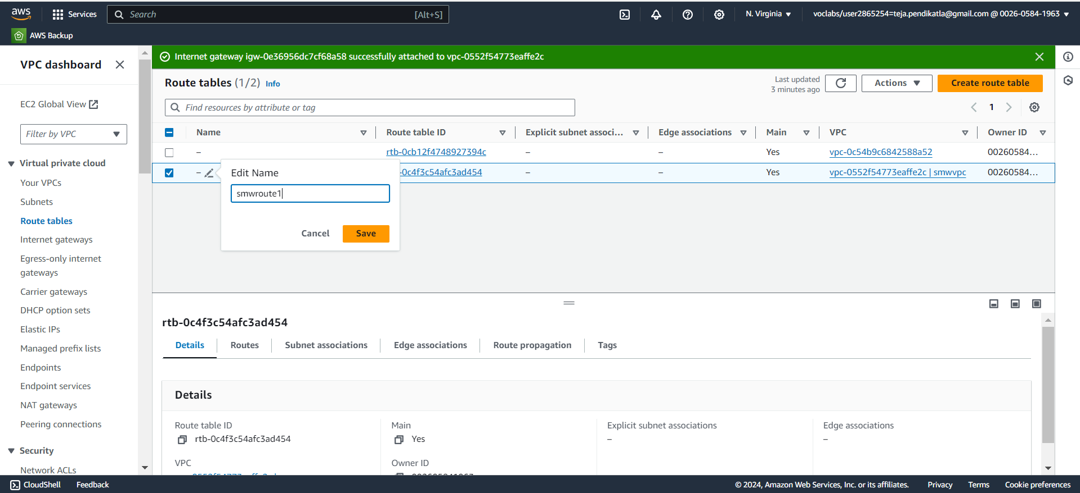
5.1 Click of Default Route Table & Change the name.

Slide 28
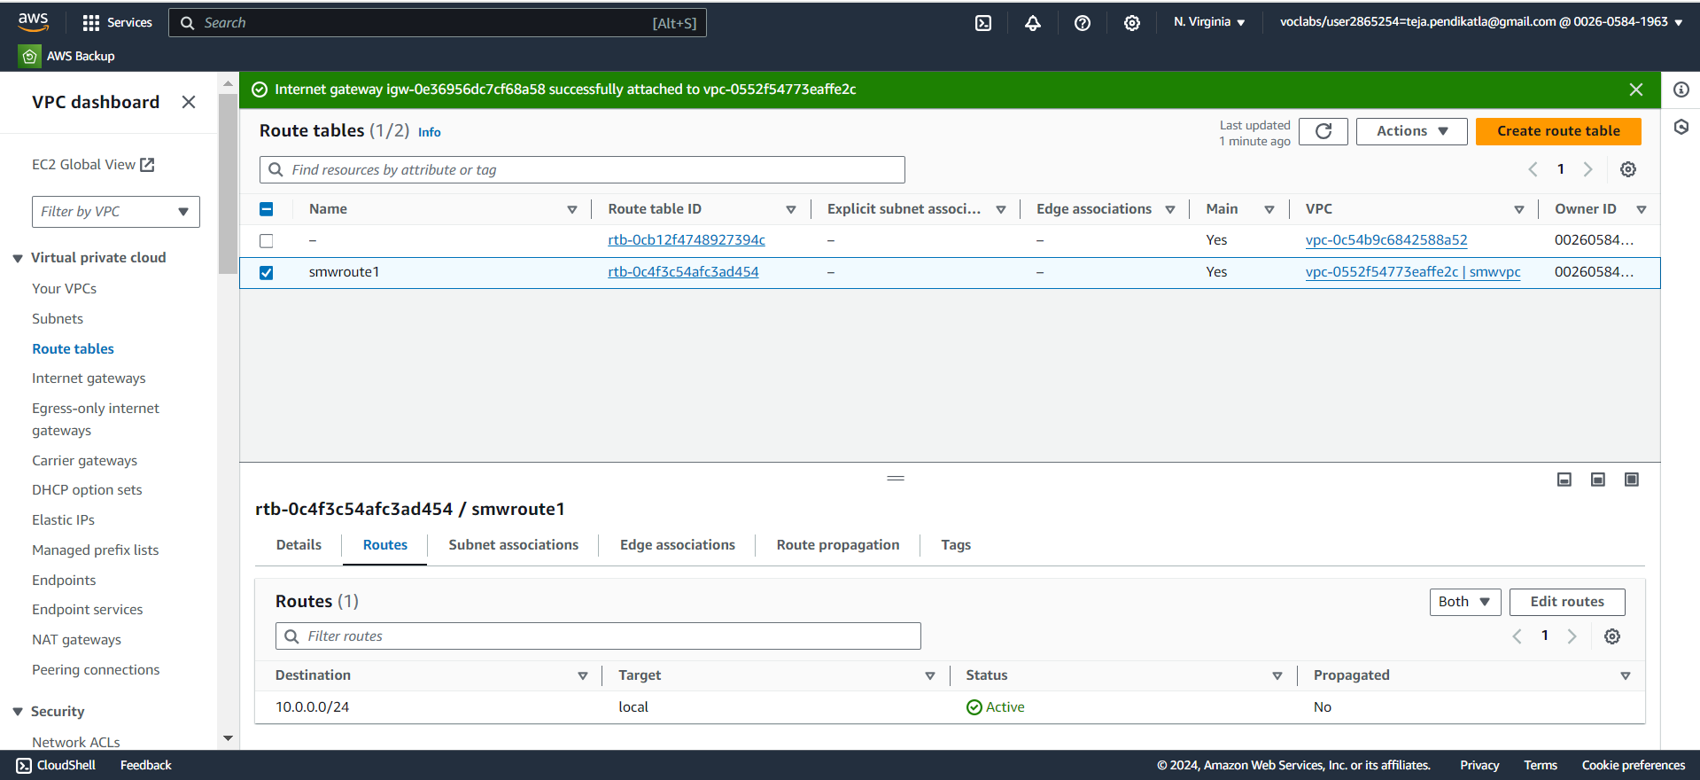
5.2 Select Default Route table , Click on Routes & Click Edit routes.

Slide 29
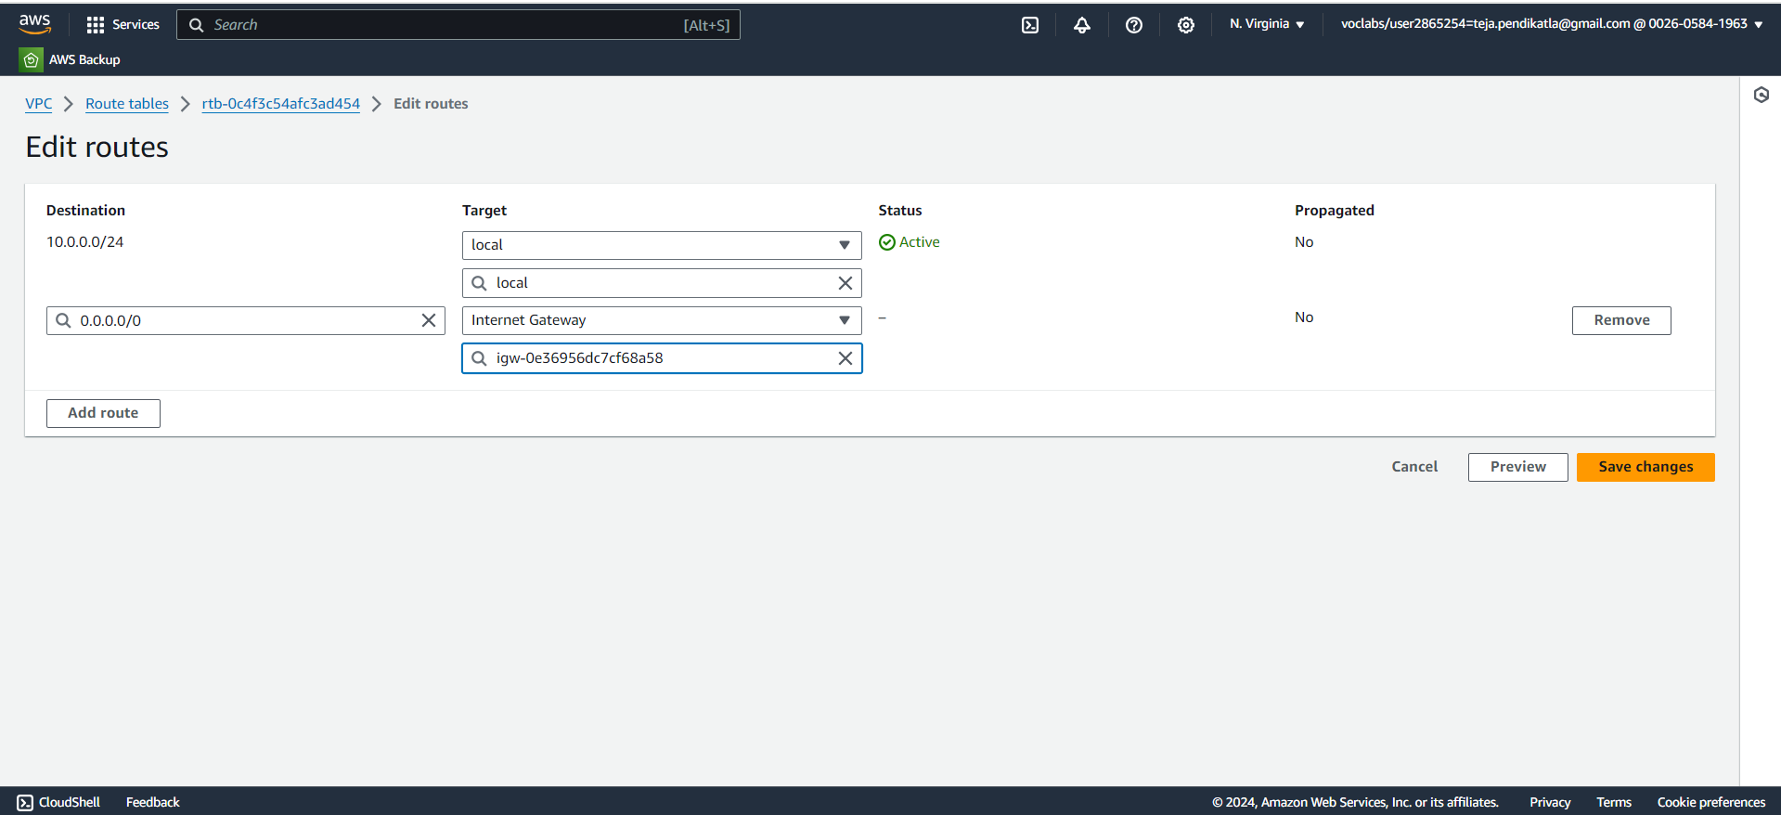
5.3 Follow the steps in Setup Default Route table of VPC.

Slide 30
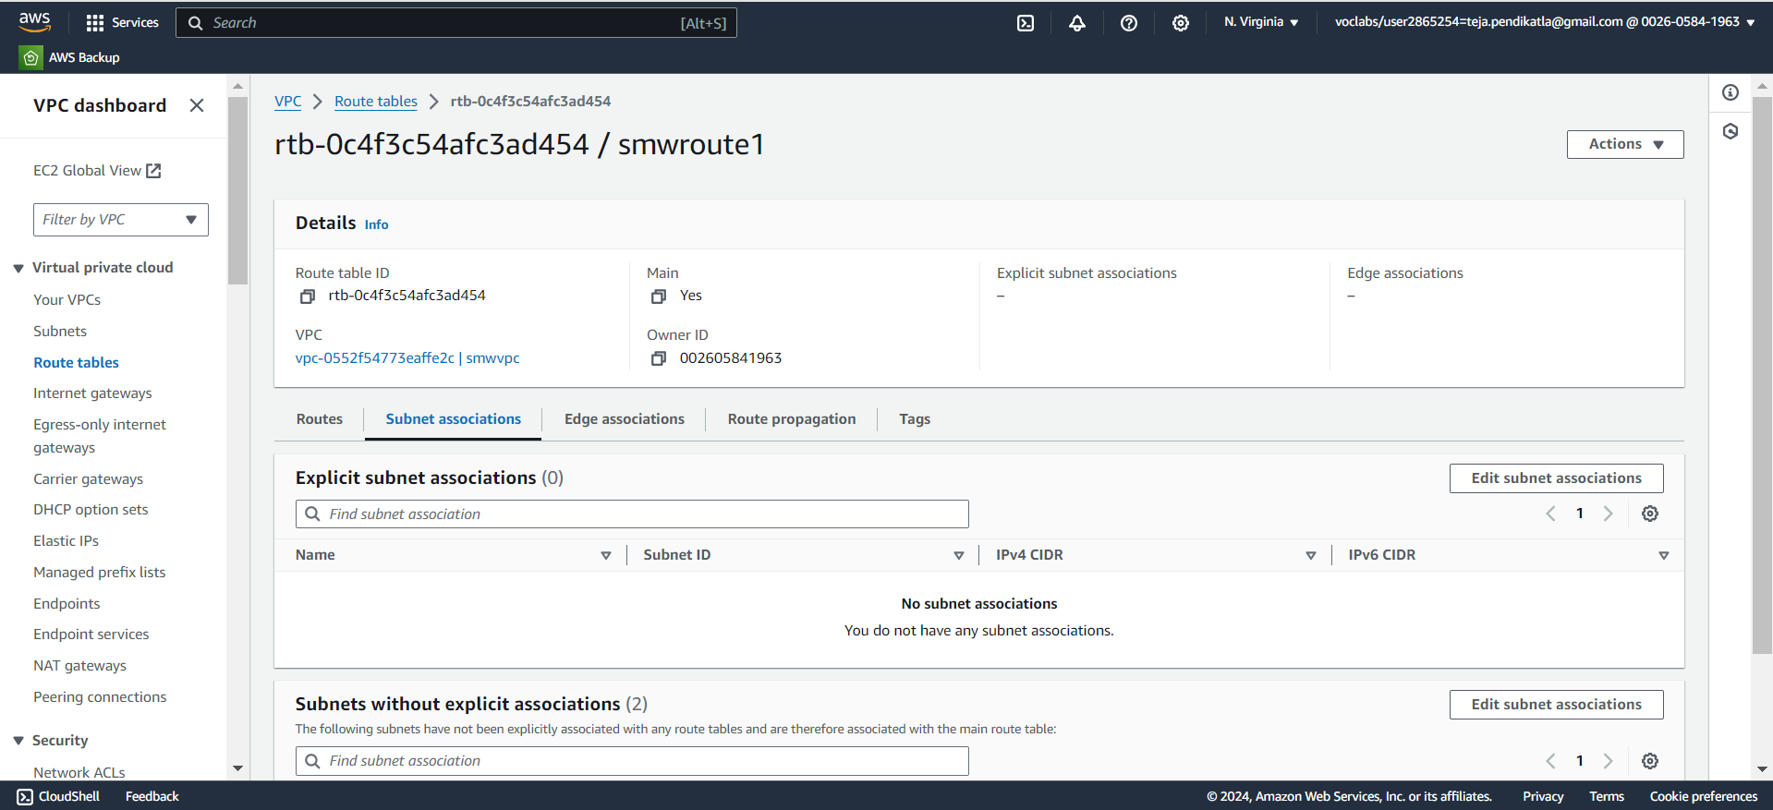
5.4 Click on Subnet Associations & Click on Edit Subnet Associations.

Slide 31
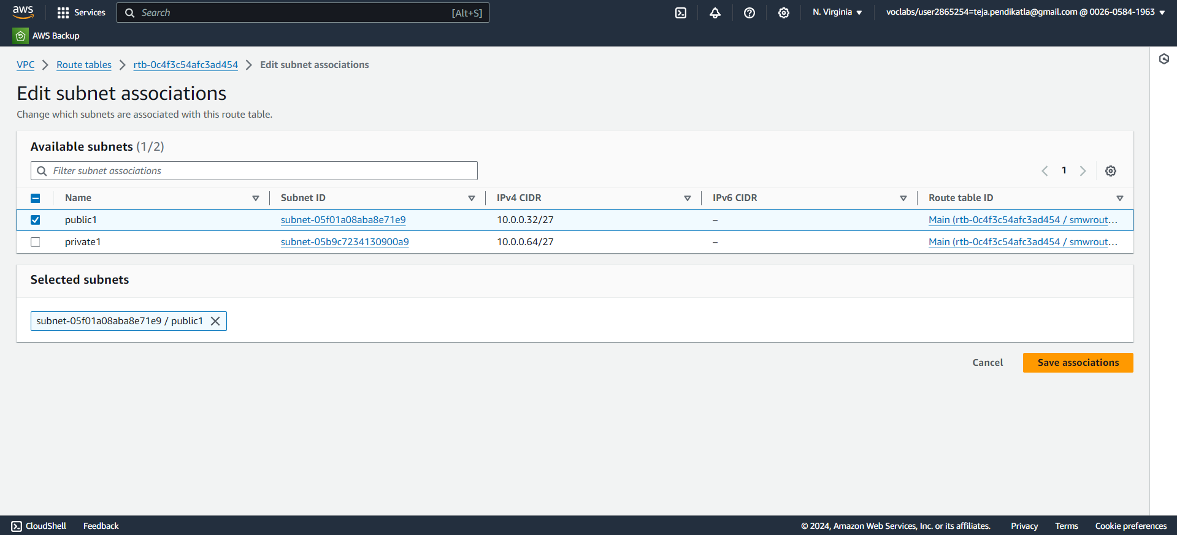
5.5 Follow the steps in Setup Default Route table of VPC.

Slide 32
6.Setting up NAT Gateway
1.Open NAT Gateways in VPC Dashboard.
2.Click on Create an NAT Gateway , give name to the NAT Gateway as smwNATgw.
3.Select public1 subnet, & Click on Save associations.
4.Click on Create NAT Gateway.
5.Open Route table in VPC Dashboard, Create a new route table with name as smwroute2.
6.Select the created VPC & Create Route Table.
7.Select the newly created Route Table , Click on Routes.
8.Click on edit route and add route – Choose 0.0.0.0 in left dropdown & Choose NAT Gateway in Right dropdown and exactly down to it select created NAT Gateway.
9.Click on Save changes.
10.Click on Subnet Associations , Click on edit Subnet Associations & select the private1 subnet created under VPC and Click on save changes.
11.Now we successfully updated the Routes and Subnet Associations of Default Route Table

Slide 33
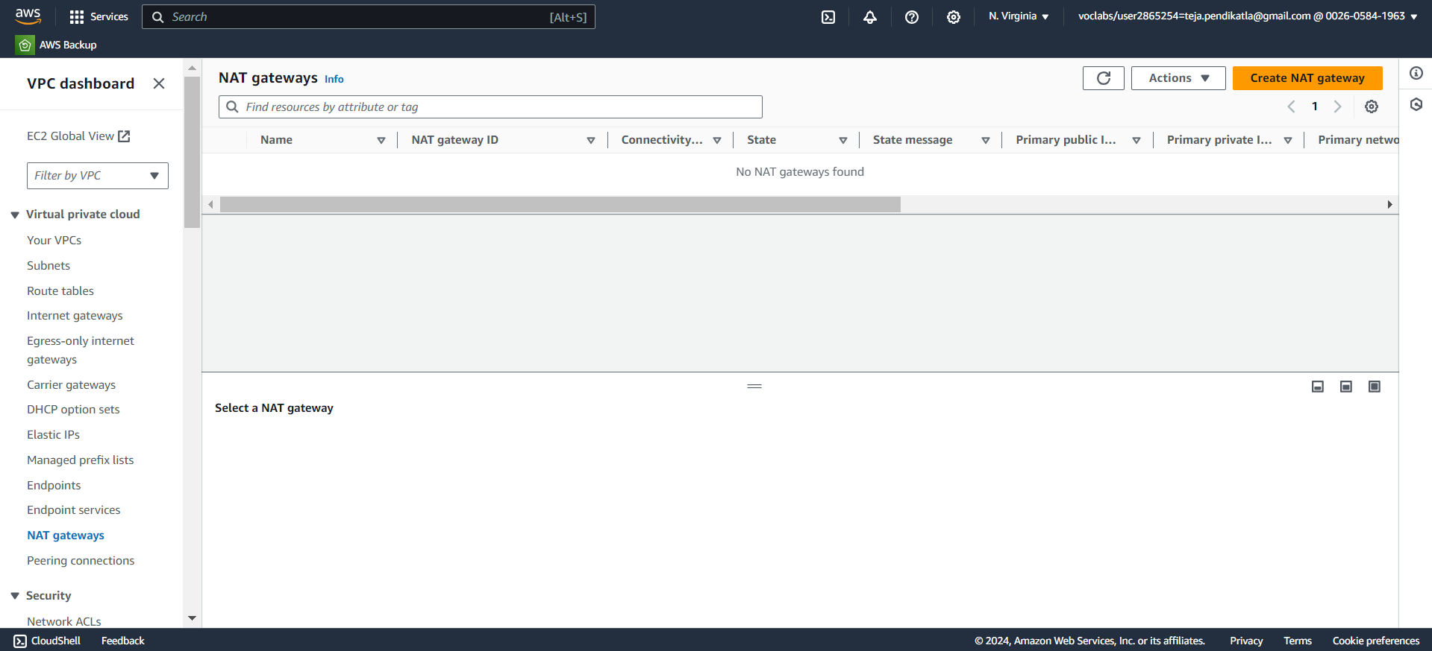
6.1 Create a NAT Gateway.

Slide 34
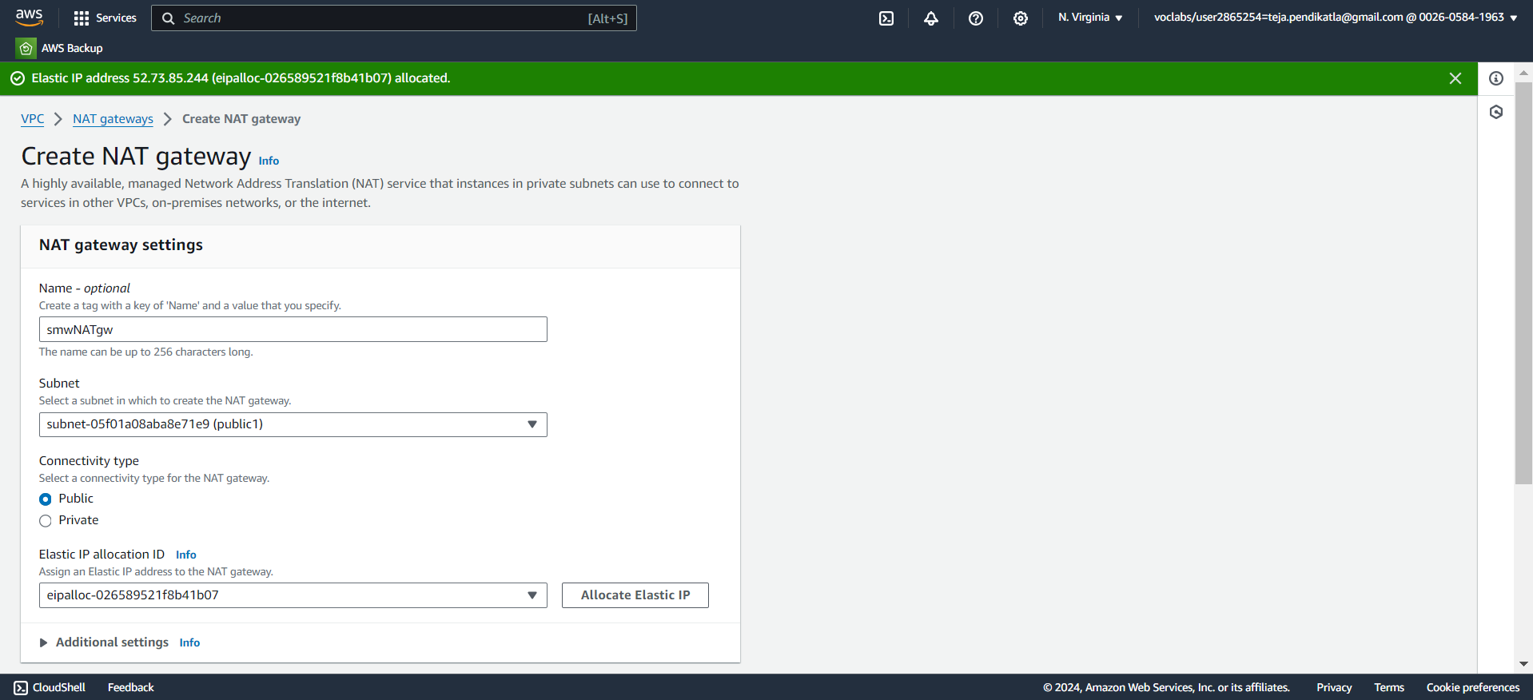
6.2 Select Public1 Subnet & Click on Save associations.

Slide 35
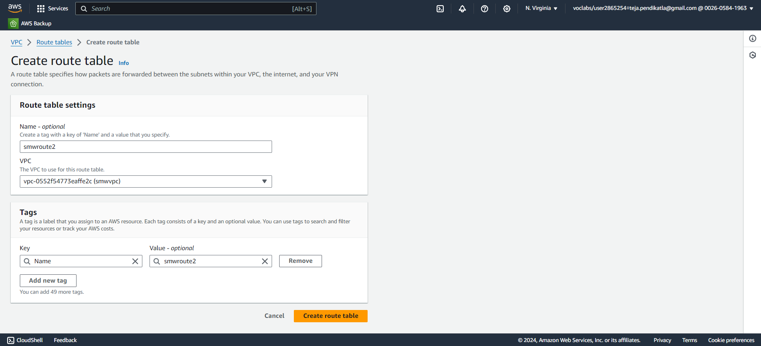
6.3 Create a New Route table & Select “smwvpc” in VPC.

Slide 36
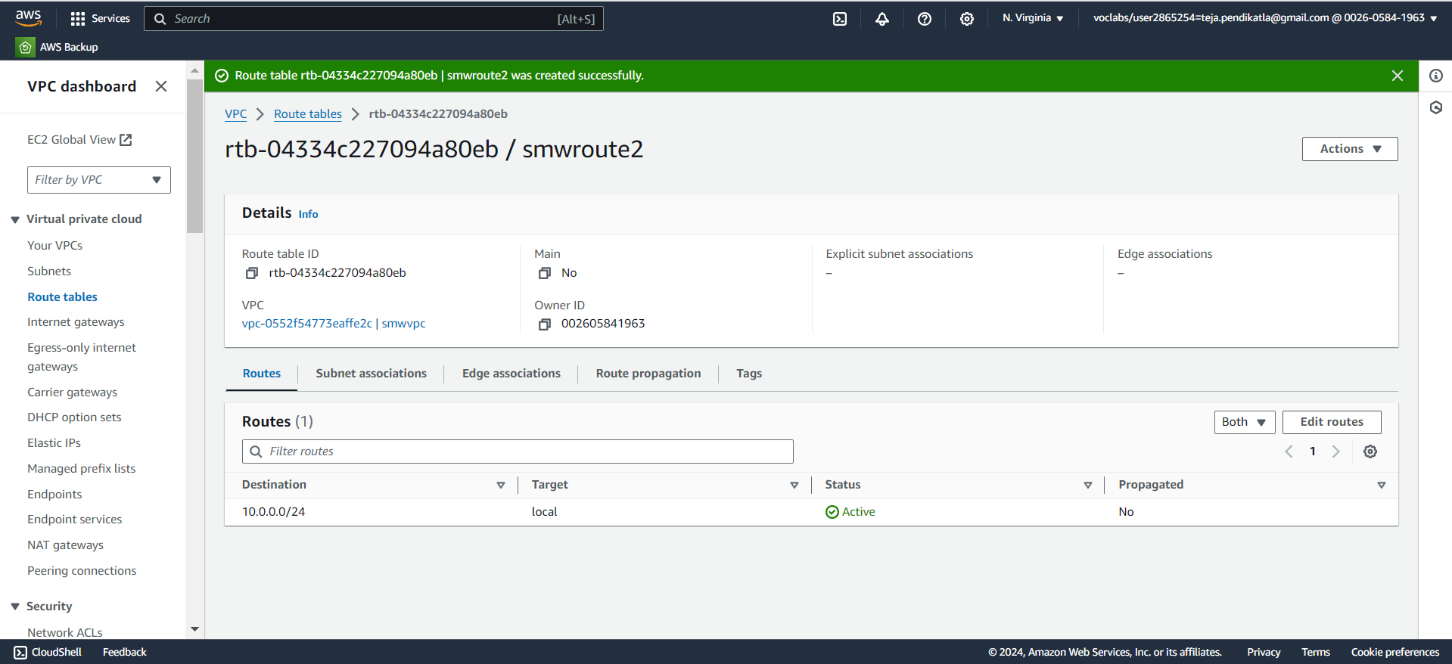
6.4 Click on Routes in New routetable & Click on Edit Routes.

Slide 37
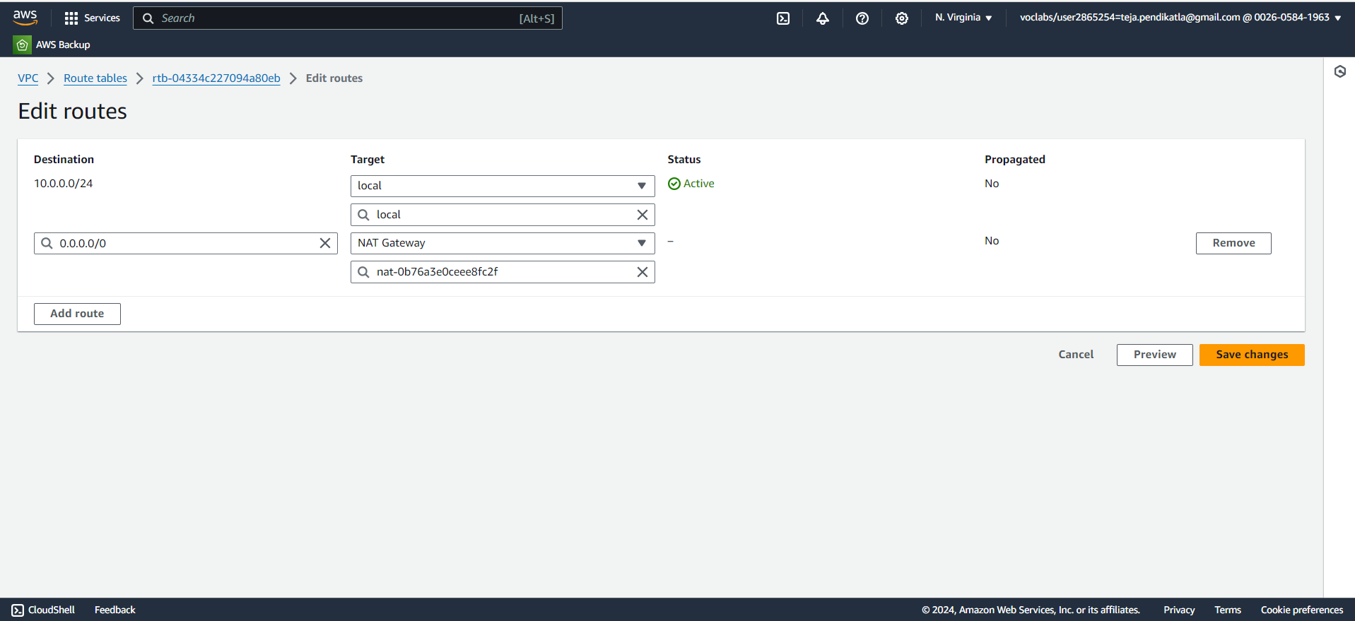
6.5 Follow the steps in Setting up NAT Gateway.

Slide 38
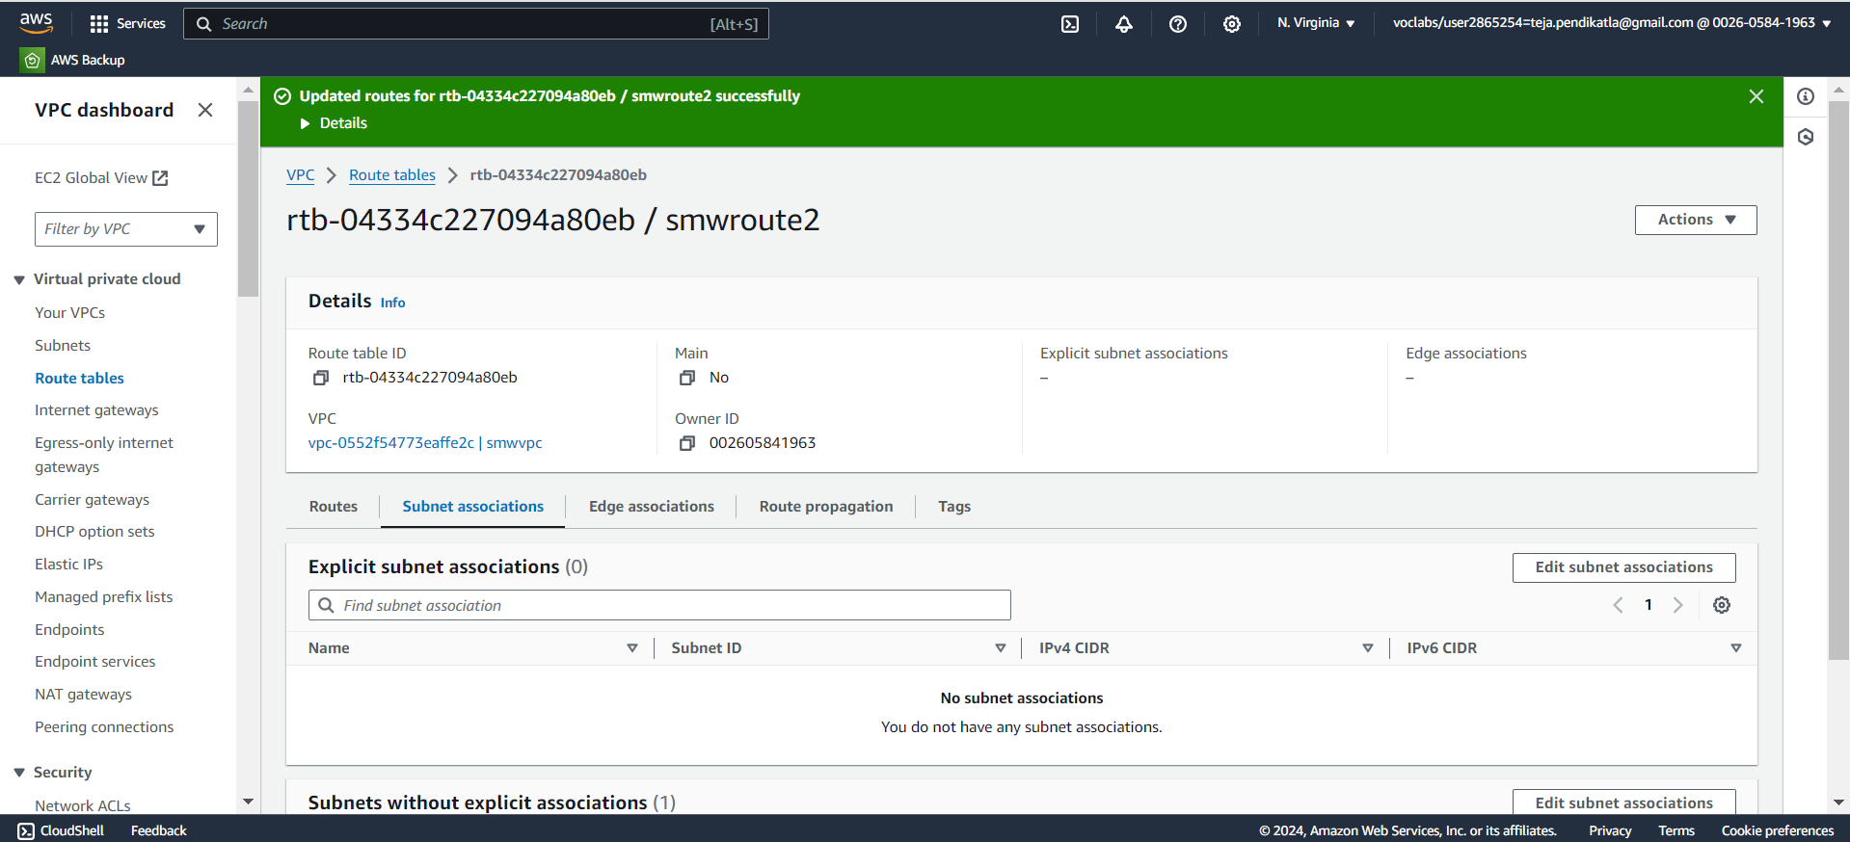
6.6 Click on Subnet Associations & Click Edit Subnet Associations.

Slide 39
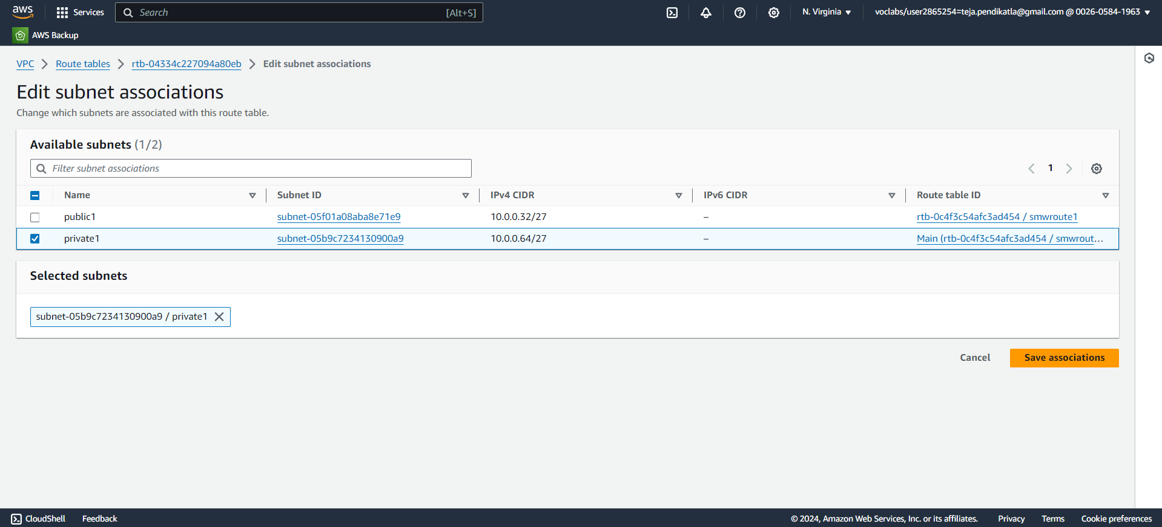
6.7 Select the Private 1 Subnet & Save associations.

Slide 40
7.Setting Up Security Group & EC2
1.Open AWS dashboard in AWS Management Console , Search for EC2 in Search bar and open EC2 dashboard , In the left-hand menu, select Security Groups under Network & Security.
2.Click on Create security group , Under Name tag enter a name for your security group , Provide a description for your security group in description box.
3.In VPC ,select the created VPC ,
Add Inbound Rules : Click Add rule to define rules for inbound traffic , Select the SSH type of connection under Type. The protocol used is TCP Under Port Range enter the port number, 22 for SSH. Define the allowed IP ranges in Source, 0.0.0.0/0 for all IPs.
Add Outbound Rules: By default, all outbound traffic is allowed.
4.Click Create security group.

Slide 41
EC2
1.Open AWS dashboard in AWS Management Console , Search for EC2 in Search bar and open EC2 dashboard , In the left-hand menu, click on Instances.
2.Click on Launch Instance , Give name for instance & Select an AMI from the list - Microsoft Windows Server 2022 Base is selected.
3.Select the instance type -t2micro, Select a Key Pair-Choose an existing key pair or create a new one.
4.Adjust settings like the number of instances, network, and subnet.
5.Under Network Settings : Select the VPC and Subnets we already created and Enable Auto-assign public IP.
6.Now Configure Security Group, Select an existing security group.
7.Review the configuration of your instance & Click Launch Instance.
8.Click View Instances to see your newly created instance in the EC2 Dashboard.

Slide 42
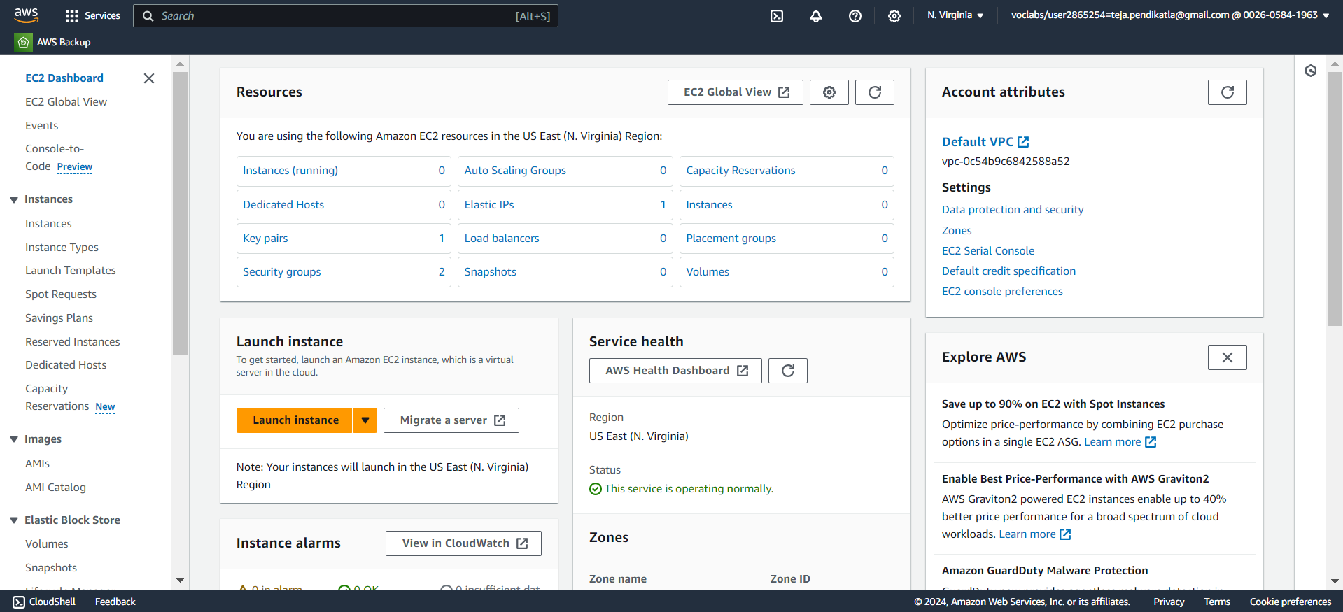
7.1 Search for EC2 in AWS Console & Open.

Slide 43
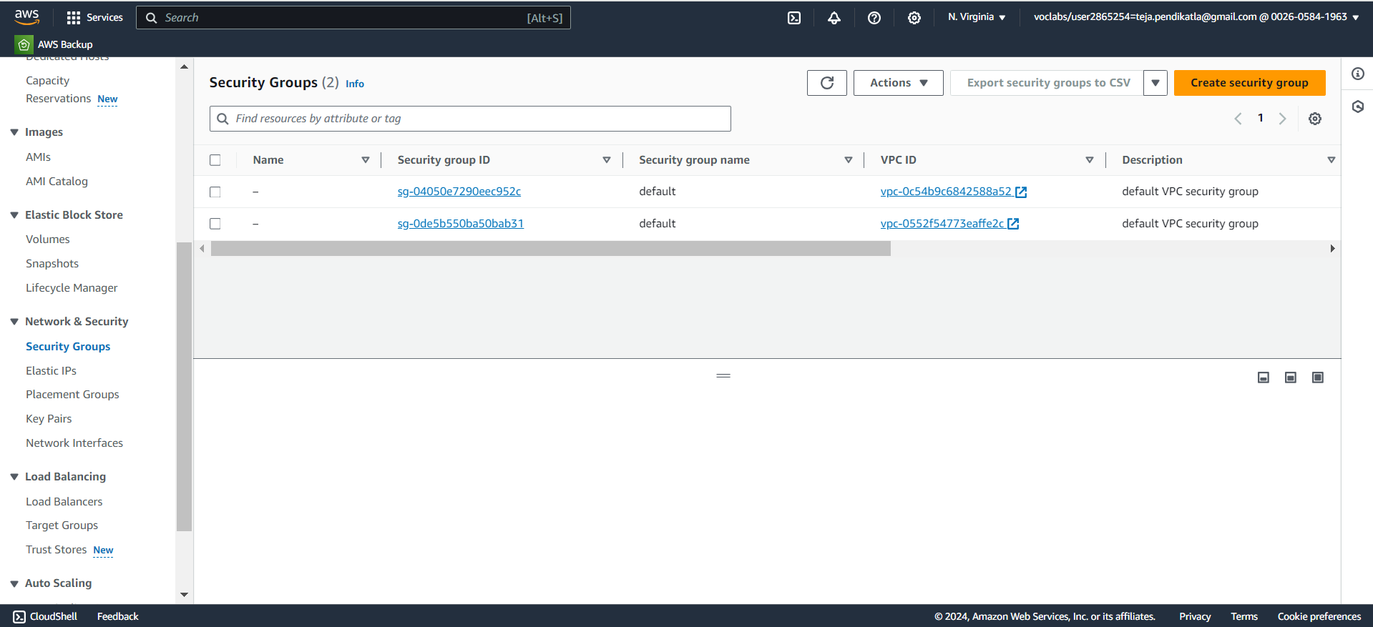
7.2 Create Security group in EC2 Dashboard.

Slide 44
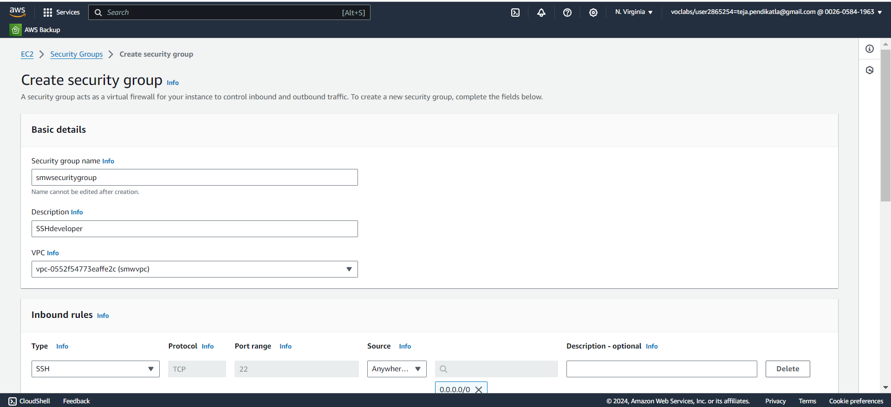
7.3 Give Name for Security Group & Select VPC.

Slide 45
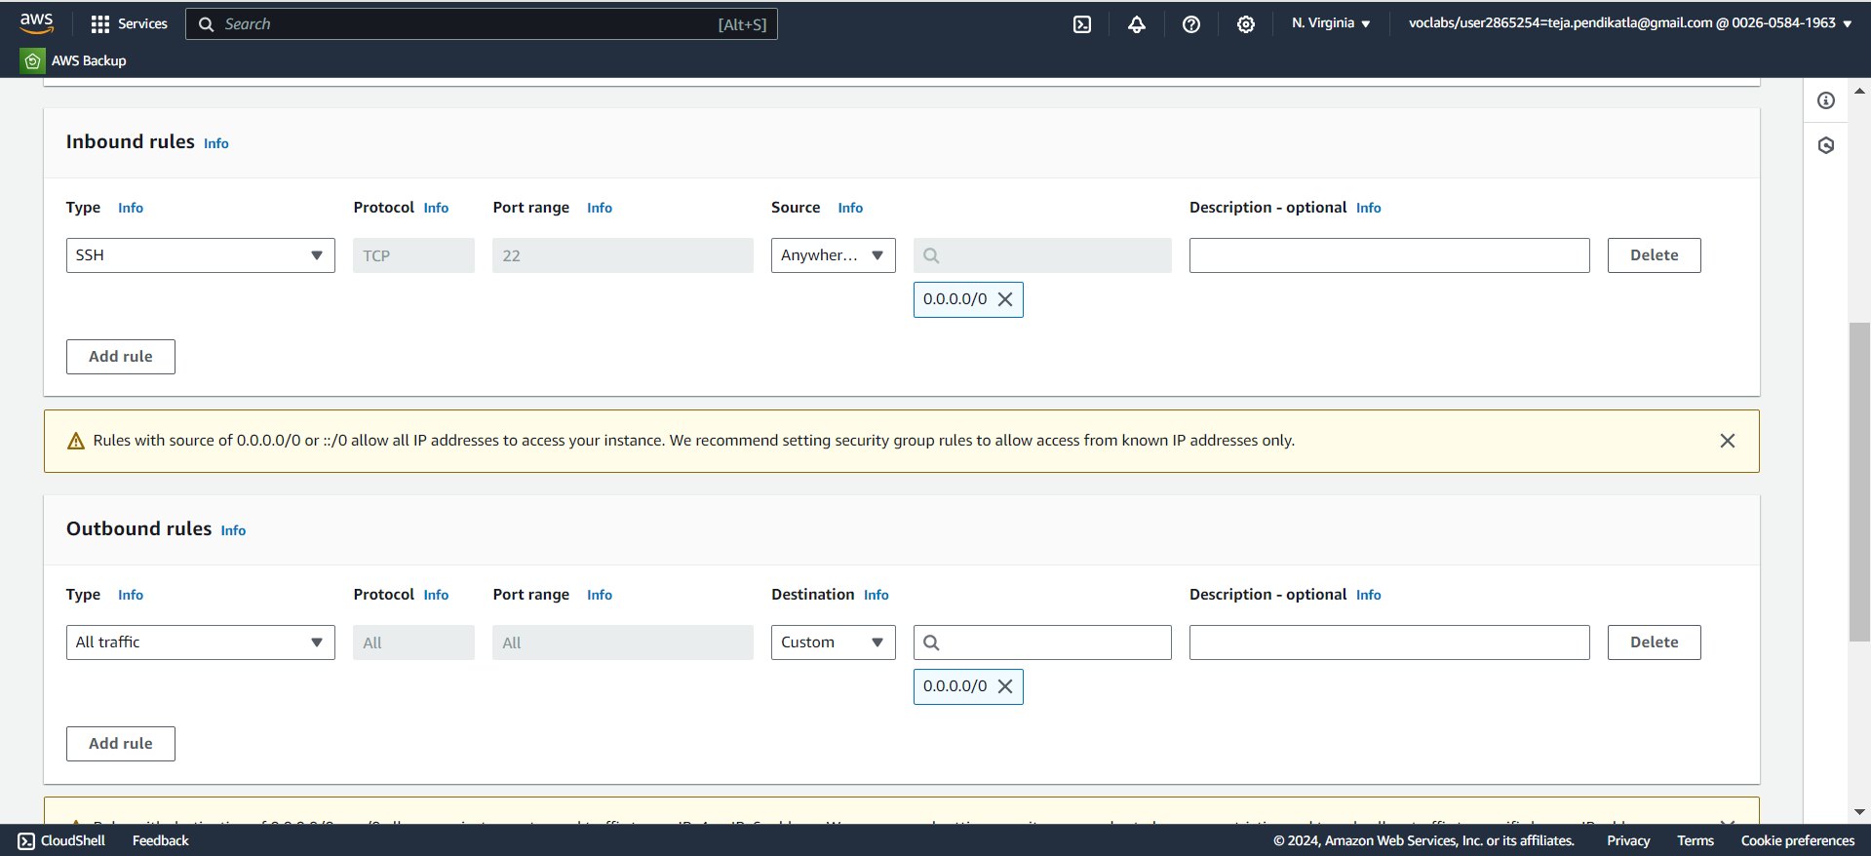
7.4 Add Inbound & Outbound rules to security group.

Slide 46
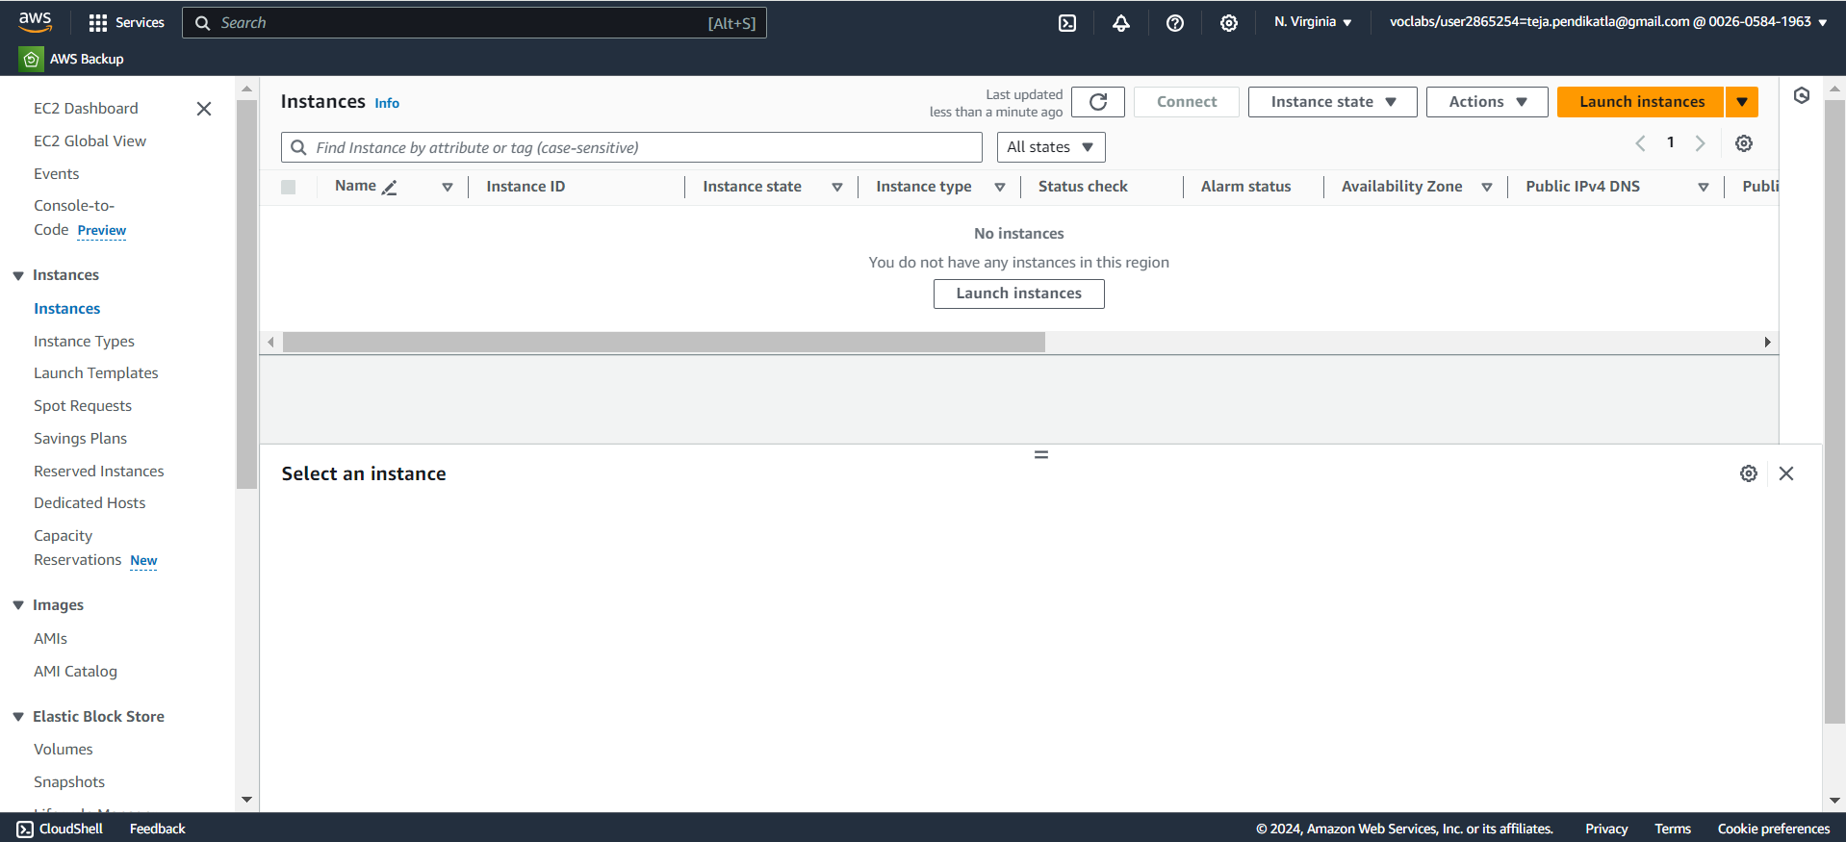
7.5 Click on Instances in EC2 Dashboard & Launch Instance.

Slide 47
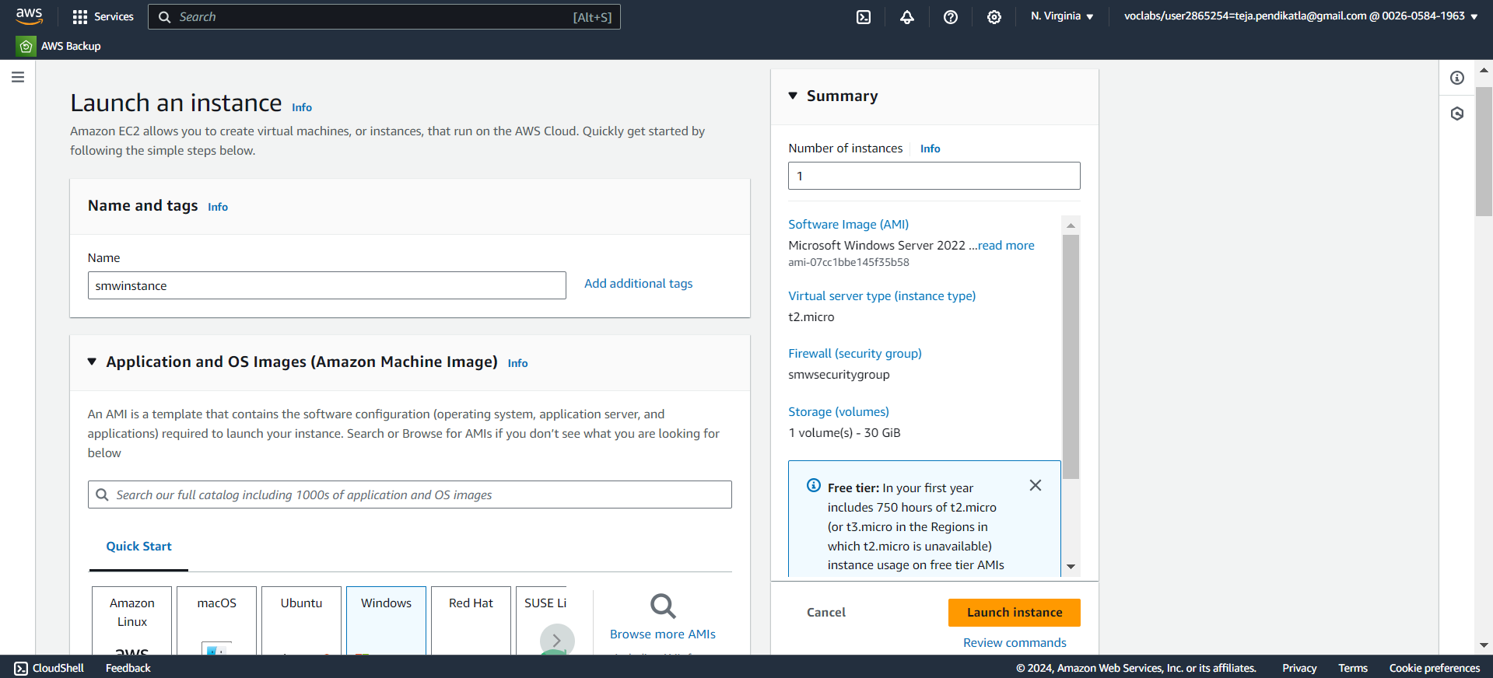
7.6 Give Name for Instance & Select AMI.

Slide 48
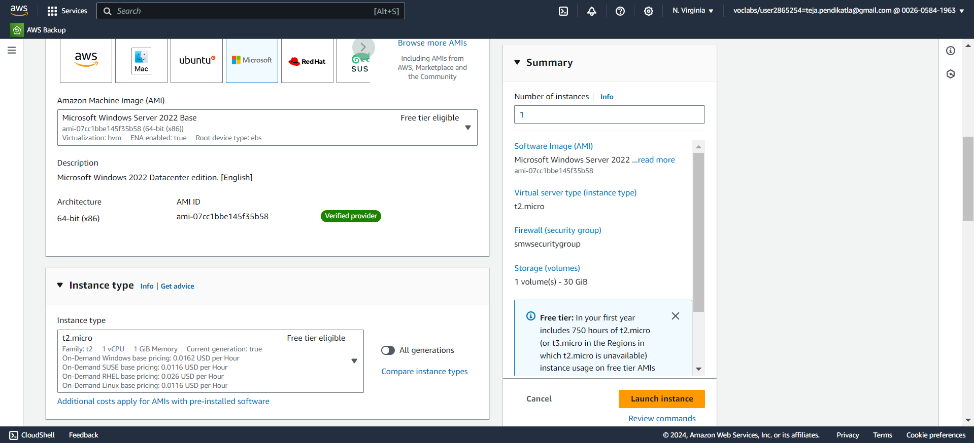
7.7 Select AMI Versions & the Instance Type.

Slide 49
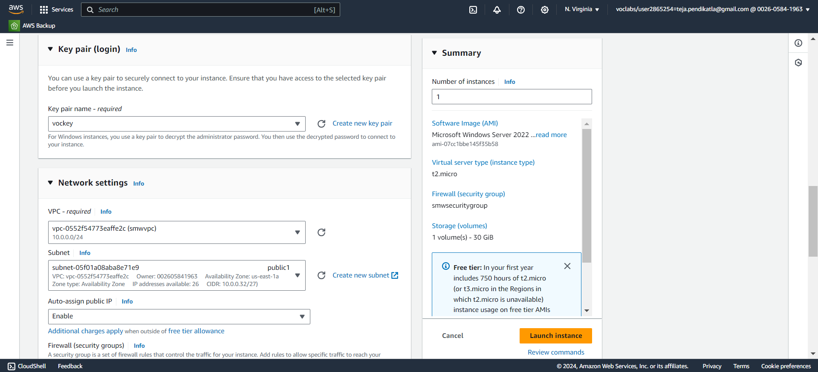
7.8 Select Key pair , Select VPC , Subnet & Enable Auto-assign public.

Slide 50
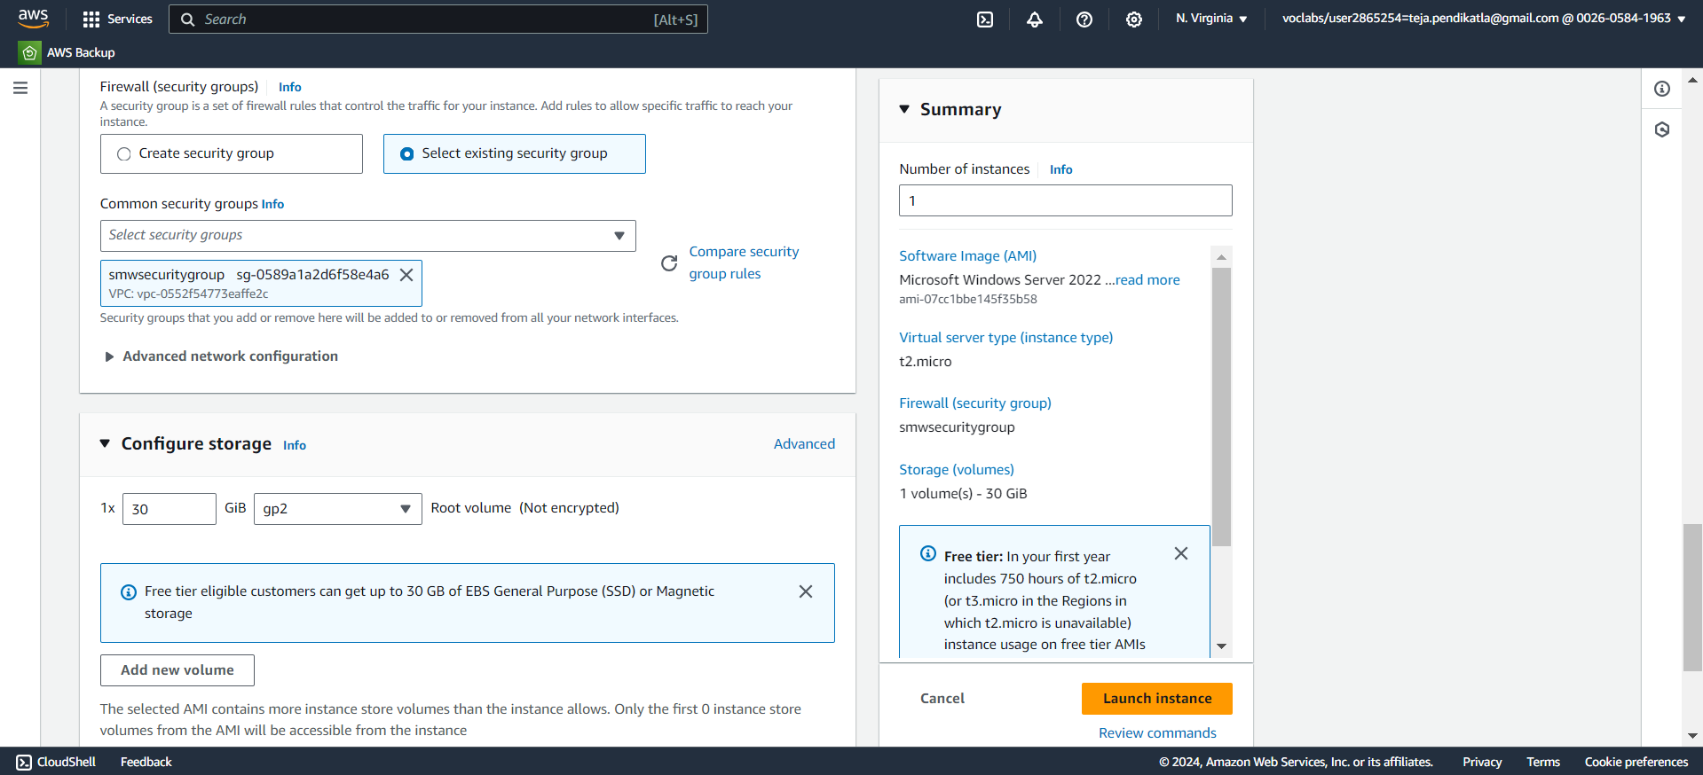
7.9 Select the Created Security Group and Launch instance.

Slide 51
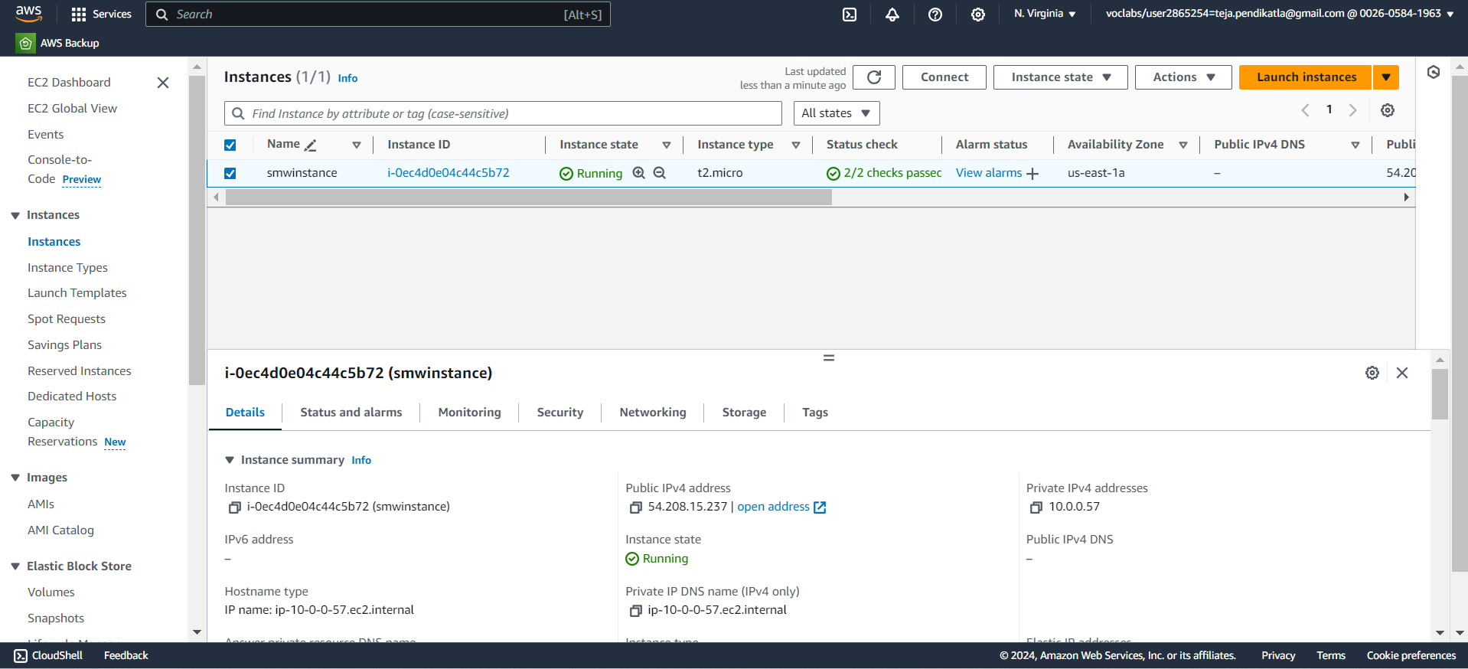
7.10 Instance is Created & Copy Instance ID.

Slide 52
8.Setting up S3 bucket
1.Open AWS dashboard in AWS Management Console.
2.Search for S3 in Search bar and open S3 dashboard, Click on Create Bucket.
3.Select the bucket type as General Purpose, Give Unique bucket name to your bucket.
4.Checkmark on Block All public Access, Select ACL’s disable in Object Ownership & Create on Bucket.
5. Select the S3 Bucket ,Click on Objects ,Click on Upload & Choose the files from your PC.
6.Click on file to be uploaded and Click on Upload.
7.When we use the Object URL of this file in S3 bucket it will be only available for your Private users.
8.If the Public Users wants to access the website.
9.Select the file in S3 bucket ,Click on permissions, Uncheck mark the “Block all public access” to convert into Public ,Copy the Bucket ARN number & Click on Edit on Bucket Policy.

Slide 53
10.Select S3 bucket policy in Select Policy type ,Click on Allow Effects & Type * in Principles.
11.Check mark All Actions , Paste the Bucket ARN and enter /* after Bucket ARN.
12.Click On Add Statement & Click on Generate Policy.
13.Copy the code from AWS Policy and Paste it in Bucket Policy & Save it.
14.Bucket Policy edited Successfully.
15. Now public users can access our website by Object URL.

Slide 54
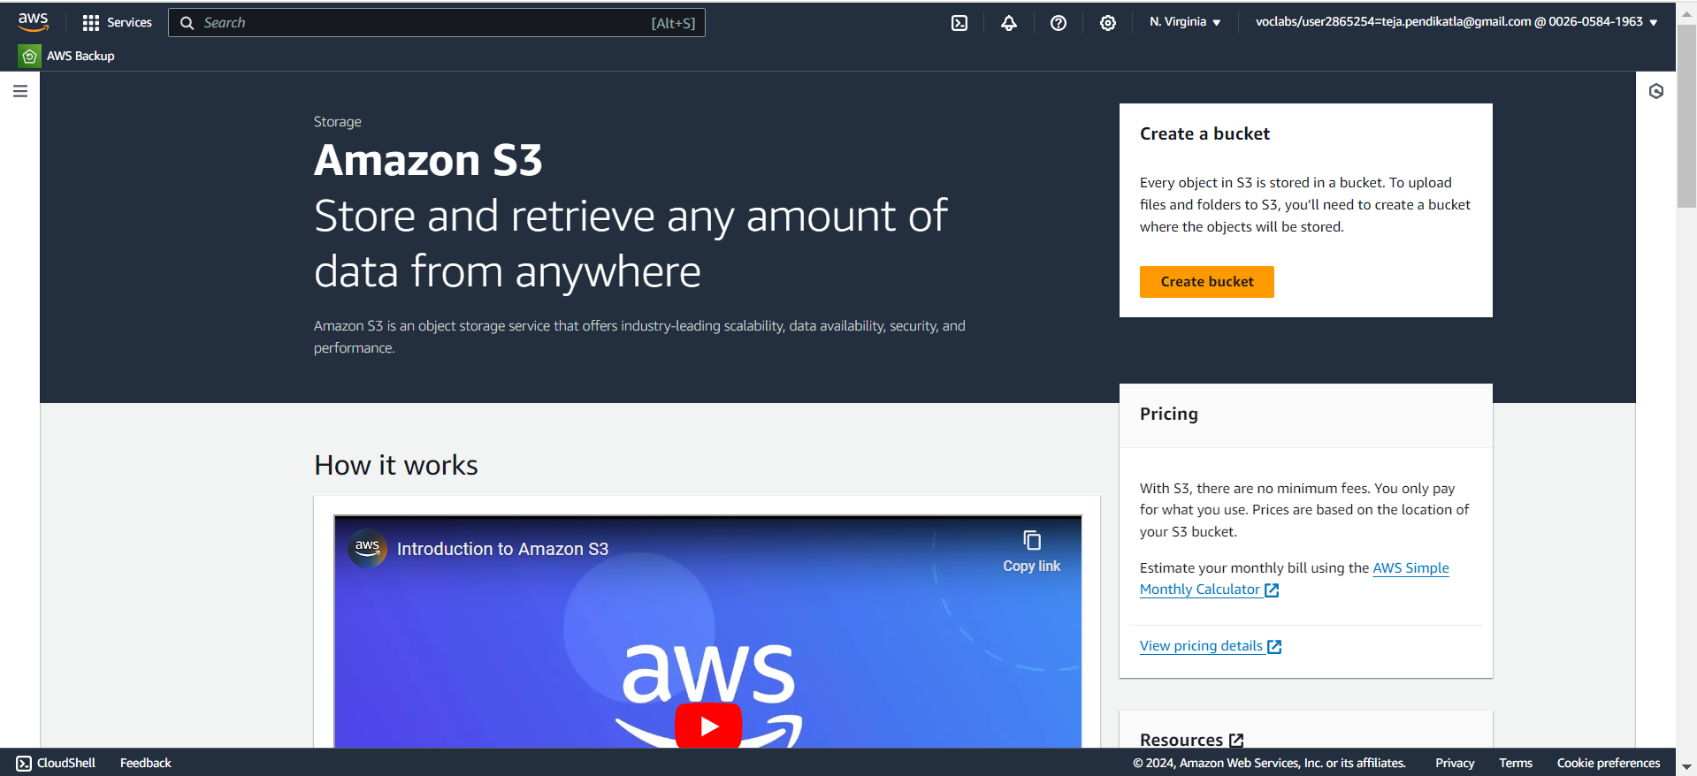
8.1 Search for S3 in AWS Console & Click Create Bucket.

Slide 55
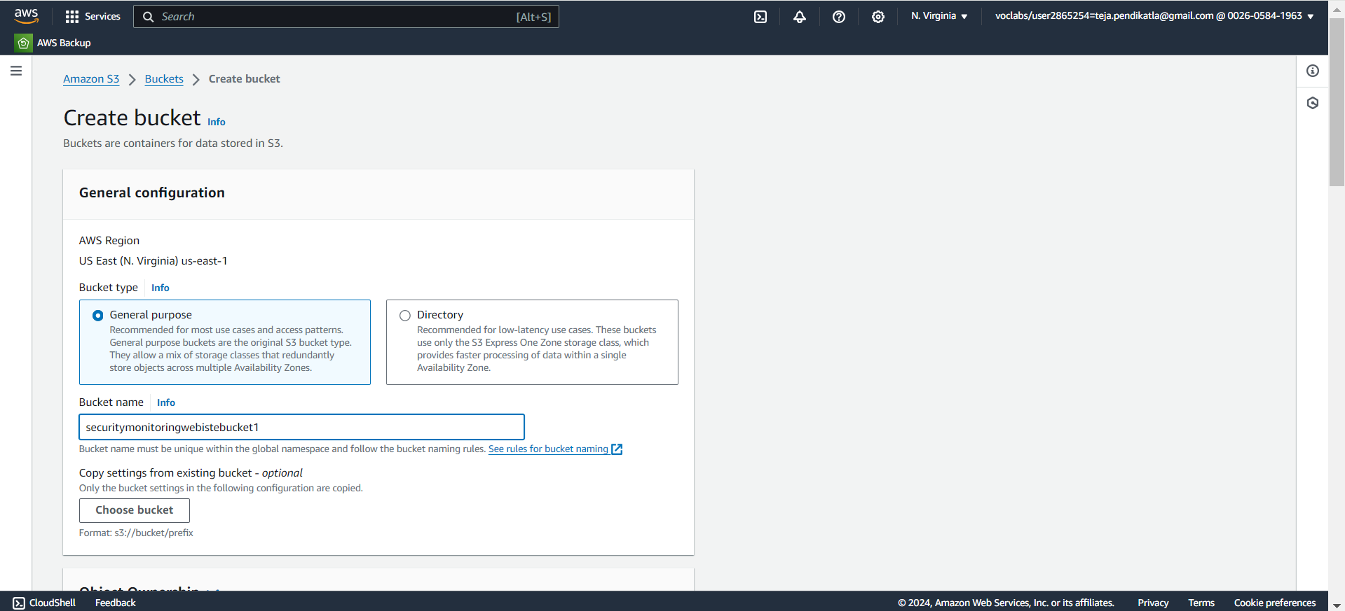
8.2 Give a unique name to the bucket.

Slide 56
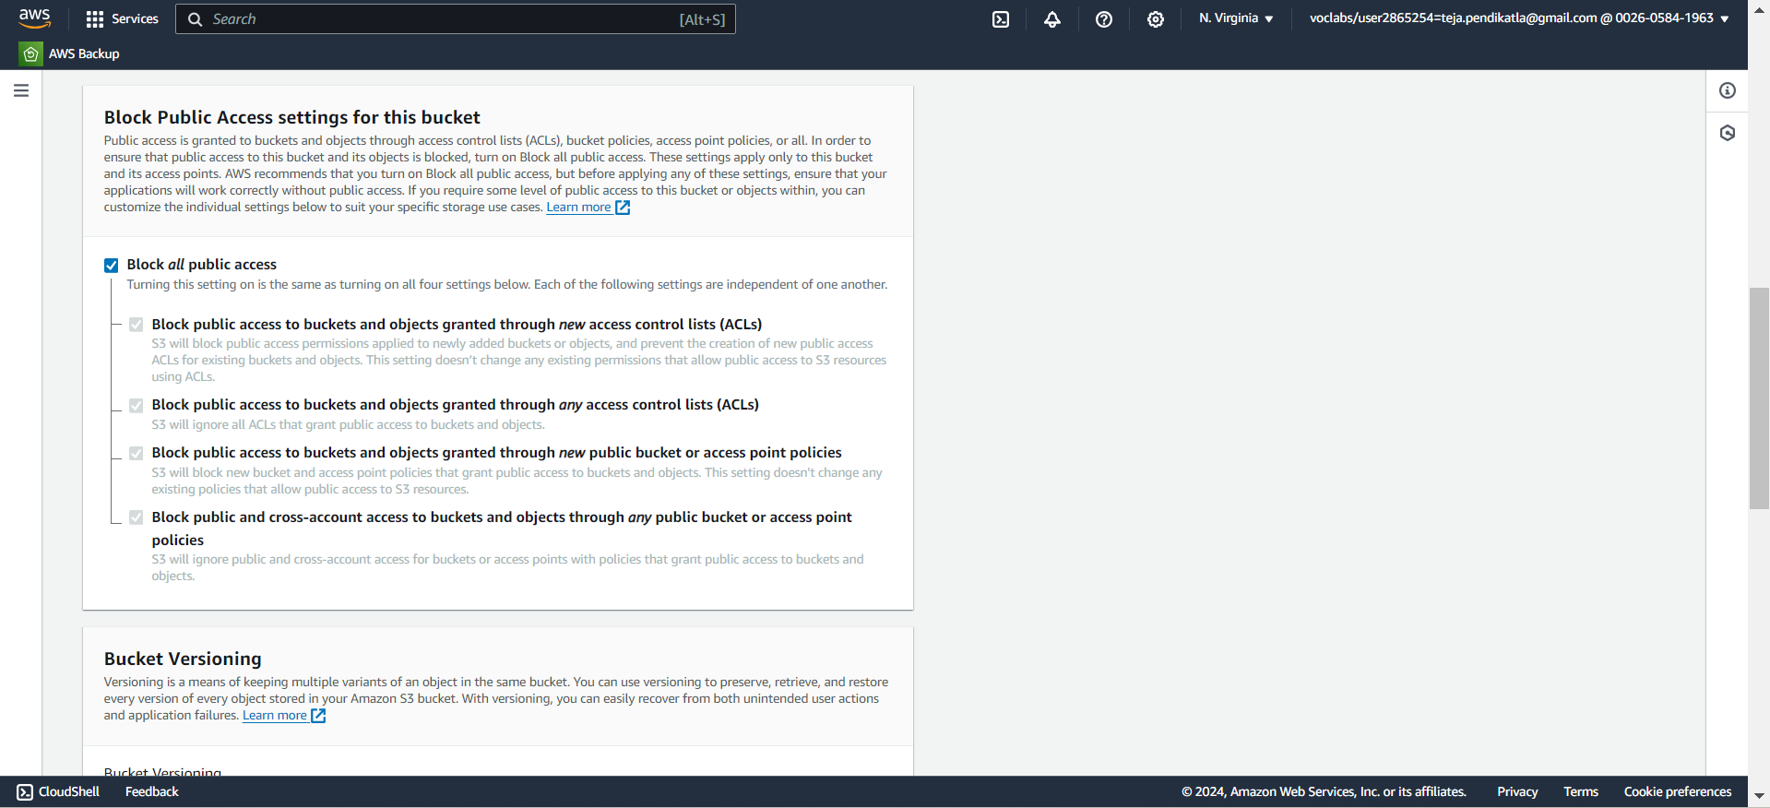
8.3 Checkmark the Block all public access : Makes Bucket Private.

Slide 57
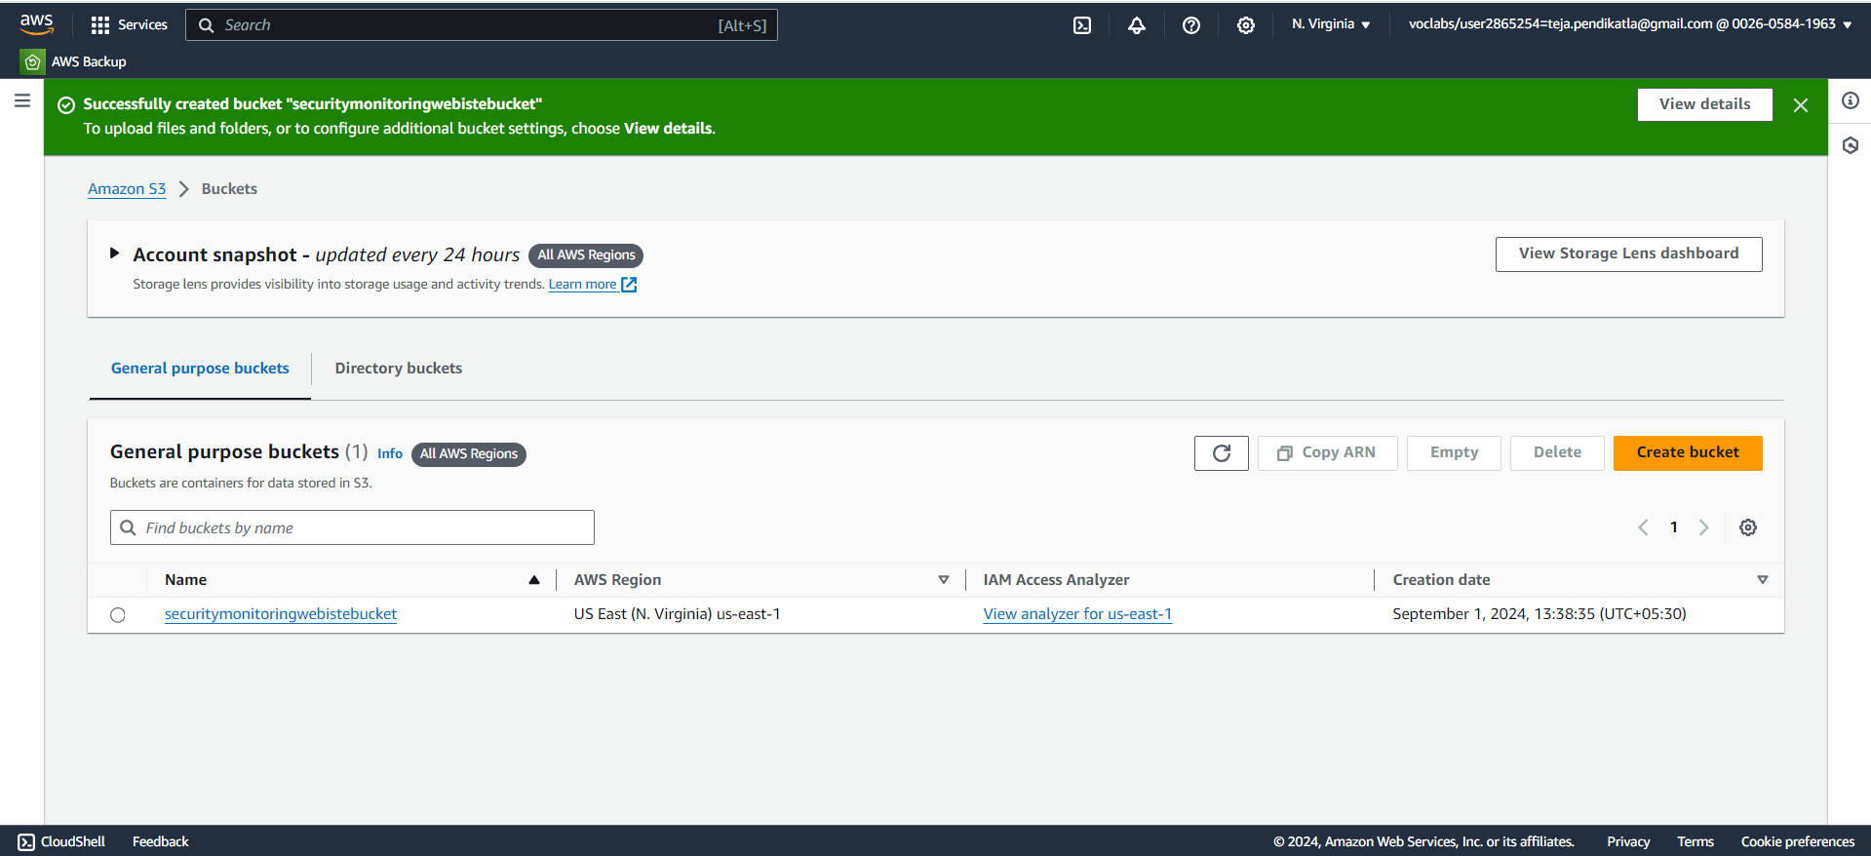
8.4 Click on Create Bucket & open it.

Slide 58
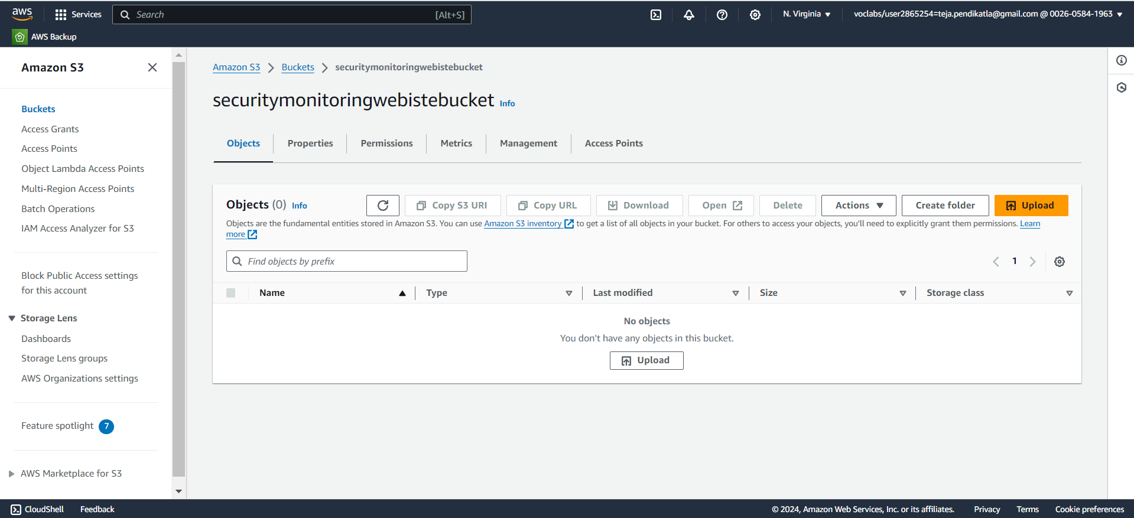
8.5 Click on Upload.

Slide 59
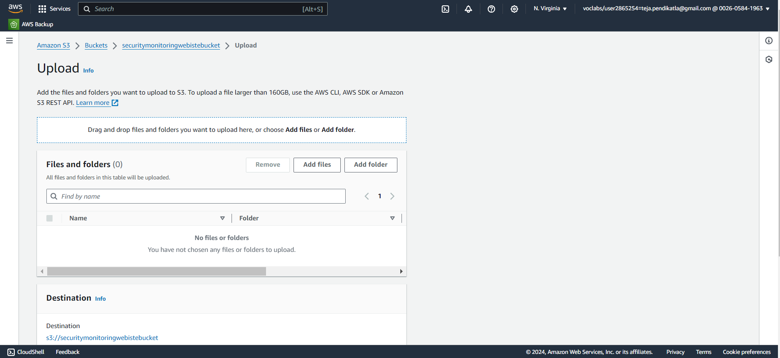
8.6 Click on “Add Files” to add files from your PC.

Slide 60
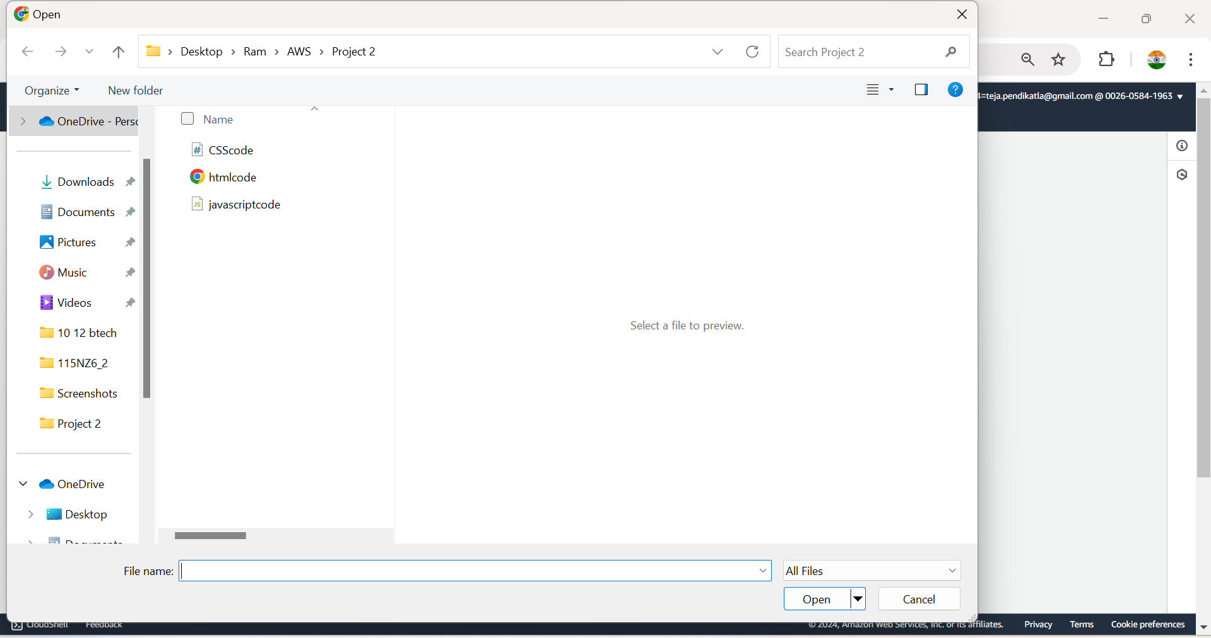
8.7 Select the Files from your PC.

Slide 61
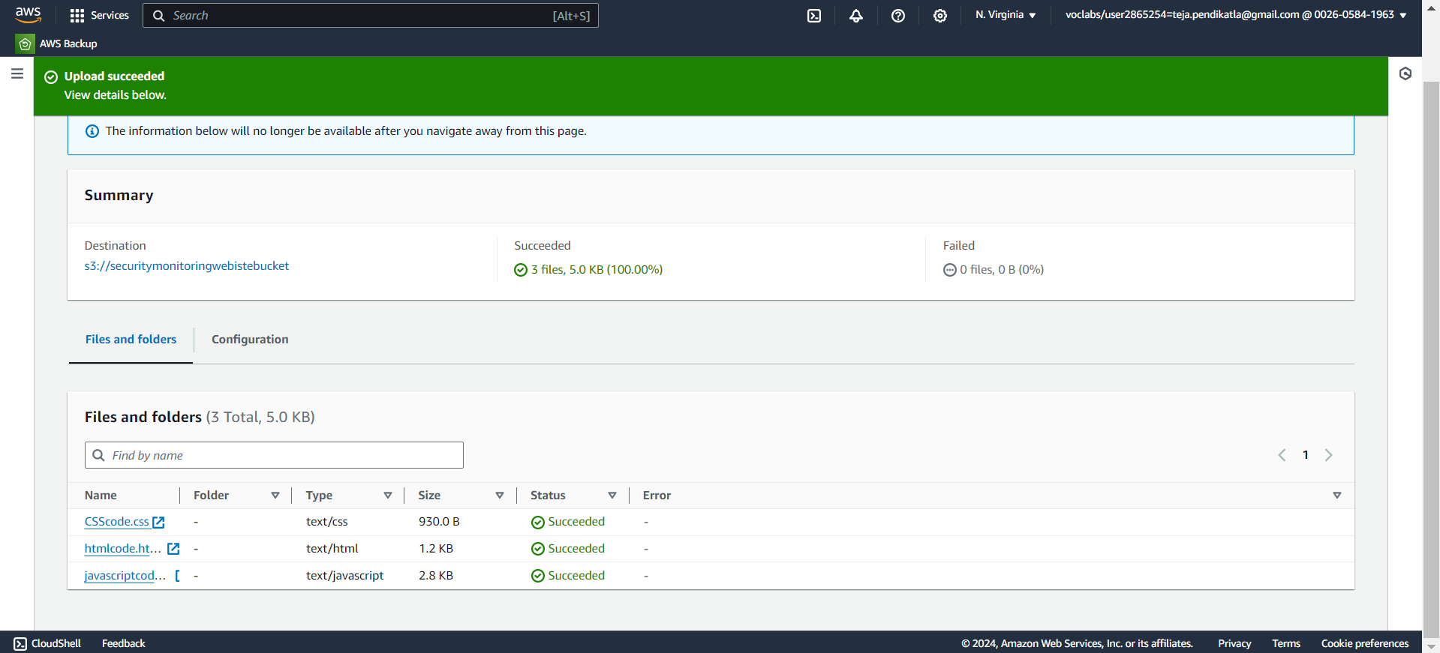
8.8 Files uploaded in S3 Bucket.

Slide 62
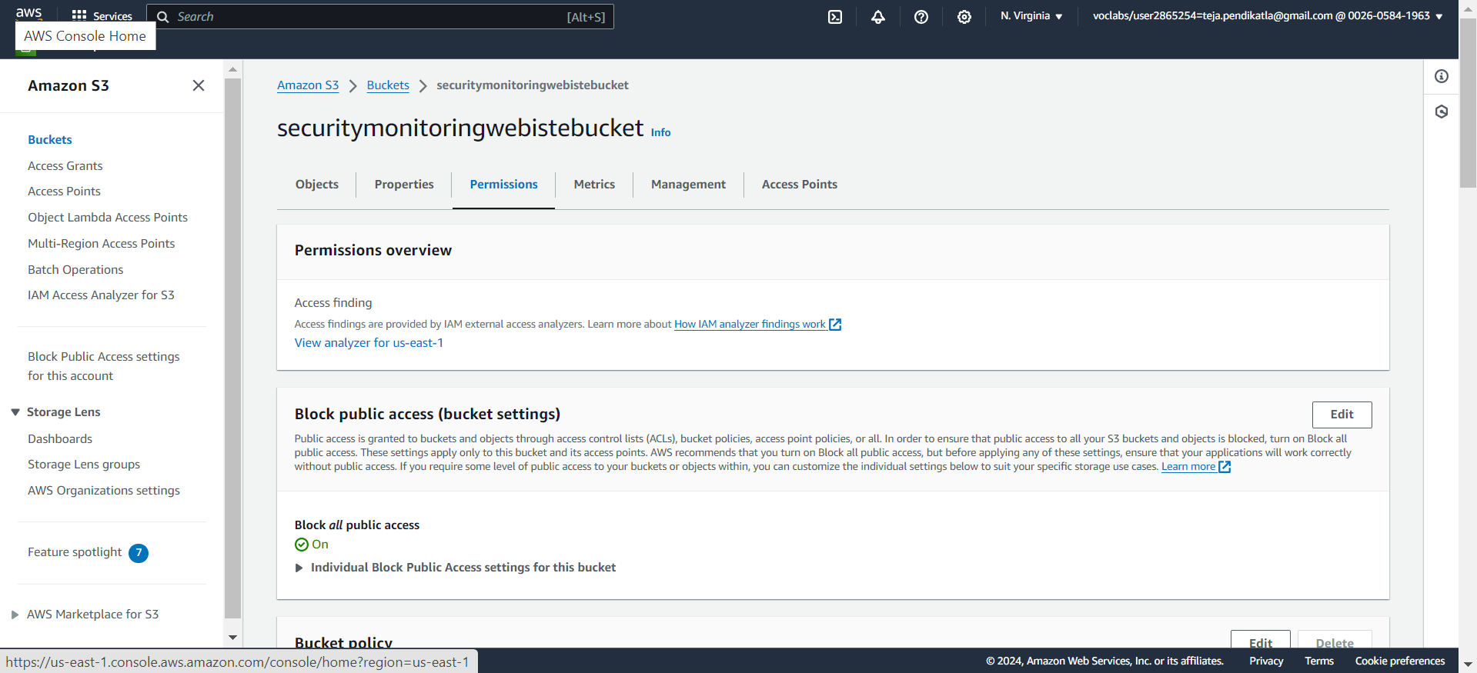
8.9 Click on Permissions & click on edit Bucket settings.

Slide 63

8.10 Uncheckmark the Block all Public access.

Slide 64

8.11 Click on edit in Bucket policy.

Slide 65

8.12 Copy the ARN Number & Click on Policy Generate.

Slide 66

8.13 Create New AWS policy.

Slide 67

8.14 Follow the steps in Generate AWS Policy.

Slide 68

8.15 Click on Generate Policy to generate Code.

Slide 69

8.16 Copy the code.

Slide 70

8.17 Paste the code in S3 bucket Policy & Save.

Slide 71

8.18 Select the htmlcode.html and copy the URL.

Slide 72

8.19 Open the link in new Tab.

Slide 73

8.20 This is your website i.e, uploaded in S3 Bucket.

Slide 74
9.Setting up Cloud Watch
1.Open AWS dashboard in AWS Management Console.
2.Search for Cloud Watch in Search bar and open Cloud Watch dashboard.
3.In the left-hand menu, click on Dashboards & Click on Create dashboard , Create Custom Dashboard.
4.Enter a name for your dashboard in the Dashboard name field & Click Create dashboard.
5.After creating the dashboard, you’ll be prompted to add widgets , Click Add widget & Choose the type of widget you want to add.
6.Select the Data type - Metrics in Widget Configuration. Choose the metrics you want to display. You can select metrics from various AWS services or custom metrics. Click Next.
7.In Add query select the service you need to monitor , here we selected EC2 and select one from the given options for the representation based on the CPU utilization of the instance.
8.In Browse paste the Instance id , Select the instance need to be monitored and click on Add widget.
9.After you’ve added and configured all your widgets, click on Save dashboard to save your changes.
10.Once you click on save dashboard you can view the graphical visualization of the Instance Monitoring.

Slide 75

9.1 Search for Cloud Watch in AWS Console & Create Dashboard.

Slide 76

9.2 Create Dashboard in AWS Cloud Watch.

Slide 77

9.3 Add Widget ,Widget type & Click on Next.

Slide 78

9.4 Add the Query based on requirement.

Slide 79

9.5 Copy the Instance ID & Paste , Click on Create Widget.

Slide 80

9.6 Line graph on Average Active CPU for an Application.

Slide 81

9.7 Line graph on CPU utilization of EC2 instances sorted by highest.

Slide 82

9.8 Stacked Area of Top 10 instances by highest CPU utilization.

Slide 83

9.9 Line graph on Average Active CPU across the entire fleet.

Slide 84

9.10 Select Widget type as Number.

Slide 85

9.11 Number chart on Average Active CPU for an Application.

Slide 86

9.12 Select Widget type as Data table.

Slide 87

9.13 Number chart on Top 10 instances by highest CPU utilization.

Slide 88

9.14 Various Charts in the Cloud Watch Dashboard.

Slide 89

9.15 Instance Monitoring.

Slide 90
10.Setting up Cloud Trail
1.Open the AWS Management Console , Search for Cloud Trail & Open.
2.In the Cloud Trail dashboard, click on Trails in the left-hand menu.
3.Click on Create Trail . Enter a name for your trail - security_monitoring_logs1 in the Trail name field. Click Create trail.
4.Now the Cloud trail is created & Logs are stored in S3 Bucket.

Slide 91

10.1 Search for AWS Cloud Trail in AWS Console & Open.

Slide 92

10.2 Create a Quick trail in Cloud Trail.

Slide 93

10.3 Trail is created & Click on it.

Slide 94

10.4 Trail Dashboard , Click on trail name.

Slide 95

10.5 Click on Trail Log Location.

Slide 96

10.6 Logs are stored in S3 bucket

Slide 97


Slide 98


Slide 99


